Slide 1
Group: Definition, Functions, Types of Groups.
ERASMUS + 2019-1-PL01- KA201-06486
Asociatia Centrul de Training European - CTE

Slide 2
I. WHAT IS A GROUP?
A group is a collection of individuals who interact with each other such that one person’s actions have an impact on the others. In other words, a group is defined as two or more individuals, interacting and interdependent, who have come together to achieve particular objectives.

Slide 3
I.DEFINITION
Sherif and Sherif (1969) define a group as follows “A group is a social unit which consists of a number of individuals who stand in role and status relationship to one another stabilized in some degree at the time and who possess a set of value or norms of their own regulating their behaviour at least in matter of consequence to the group.”

Slide 4
I.1. DEFINITION
A comprehensive definition would say that a group is one where its members:
are motivated to join;
perceive the group as a unified unit of interacting with people;
contribute in various amounts to the group processes (that is, some people contribute more time or energy to the group than do Others);
reach agreements and have disagreements through various forms of interaction.

Slide 5
I.2. SOCIAL UNIT AND GROUP ROLE
Social unit means a kind of bounded system of interaction delineated from others, an in group feeling or a feeling of oneness.
Every individual member of the group has a status and some role to play in the functions of the group, to achieve the group goal. The status of the individual member of the group determines his role and functions in the group.

Slide 6
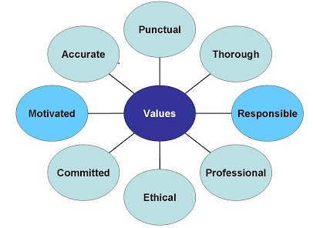
I.3. VALUES AND NORMS
Norms and values refer to a set of standards which regulate important behaviour and functions of group members. However, members of a group may not be able to develop norms for every small or big problem which they encounter during their tenure in the group. Norms must be established to regulate important activities frequently engaged in and to maintain the group as a unit.

Slide 7
I.4. CHARACTERISTICS OF GROUP
a group consists of more than one person;
they meet together to satisfy some common motive or common purpose say to collect money for flood affected persons, or national defence fund. The common motive may be biogenic or sociogenic;
the group may disintegrate when the common motive is satisfied. This refers to a temporary group.
A group can also have permanent motive or purpose like family, religious groups and different clubs which are formed to fulfil some permanent purposes. These are stable groups and continue for a long period.

Slide 8
I.5. GROUP PARAMETERS
Any group can be characterized by a series of parameters, the most relevant are:
group size - which refers to the number of members that make a group;
group composition - respectively the totality of the elements that form a group and their distribution according to certain features;
the interaction processes involved - respectively a wide spectrum of relationships intergroup: hierarchical relations, management relations, processes of verbal and nonverbal communication, socio-affective attractions and impulses, etc.
group structure - respectively the configuration of relations between members, their differentiation according to status-role;

Slide 9
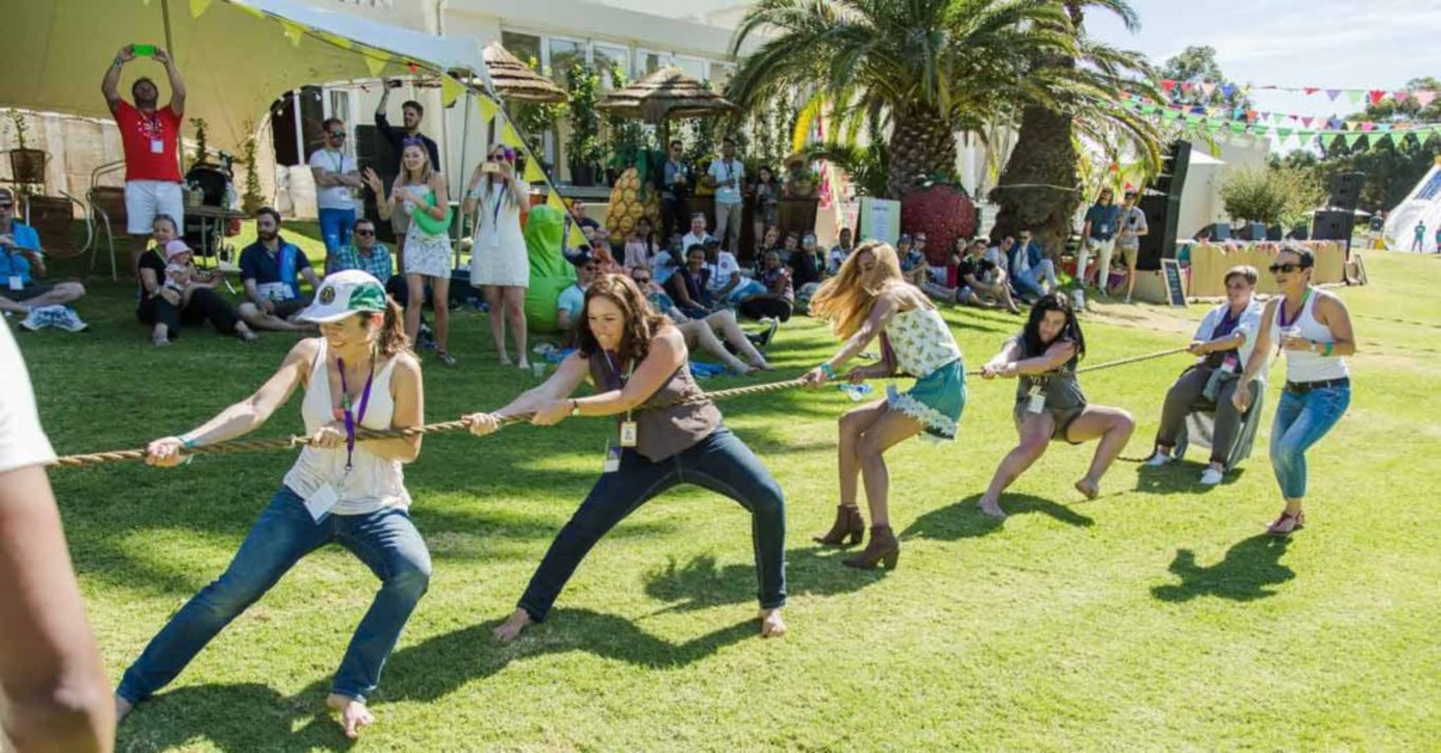
I.5. GROUP PARAMETERS
collective consciousness - respectively the intensity which the feeling is constituted of "us", of group identity;
group efficiency - respectively the performances achieved;
group cohesion - a fundamental parameter, which represents the global resultant of internal relations and common success, the effect of mutual knowledge, of acquiring the goals of the group and its norms, of the climate of mutual trust, the effect counteracting that of the dissociation of the group.

Slide 10
I.6. CRITERIA FOR MAKING A GROUP
Interaction among Group Members:
At the foundation and basic level groups must allow some forms of interaction among their members. It need not be physical face to face interaction, however verbal or written interaction may suffice.
Perception of Group Membership:
Individuals must consider themselves as members of a group.
Shared Goals and Norms:
People become a member to a group to achieve some goals such as to avoid loneliness, to promote freedom of speech or to promote a particular cause. The existence of shared norms is a very important characteristic of a formal group.
Fate Interdependence:
Events that affect one group member affects other group members and can affect the ability of the group to meet the goals for which it may have been formed

Slide 11
II. FUNCTIONS OF GROUPS
The group is the context that stimulates the search for solutions, produces socio-cognitive conflict, facilitates the knowledge of alternative frames of reference.
The functions of the group are:
Satisfaction of Needs;
Loyalty of the Members;
Belief for the Group.

Slide 12
II. FUNCTIONS OF GROUPS
Satisfaction of Needs:
Satisfaction of needs of individual members is supposed to be the most essential features of the function of a group. People join different groups and societies for satisfaction of different needs. For example, people join photographic society, music associations, health clubs, dance clubs, psychological or economic society according to their respective interests.

Slide 13
II. FUNCTIONS OF GROUPS
Loyalty of the Members:
The group loyalty will depend upon the extent to which the group satisfies the vital needs of the individual members. These vital needs are social and biological. In a social context, the need for dominance or belongingness, recognition, prestige etc. are important.
More a person identifies with a group with the hope of satisfaction of his needs, more will be the loyalty to that group. Smooth group functioning is closely inter-related with such membership loyalty.

Slide 14
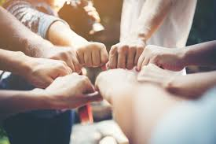
II. FUNCTIONS OF GROUPS
Belief for the Group:
Just as people have common needs in a group, a common belief also serves as uniting the different members of the group. Different values for the group are also connected with the beliefs. The degree to which a group can live up to its values and beliefs with more solidarity is to be expected in the group.

Slide 15
III. TYPES OF GROUPS
The main types of Groups are:
Primary and Secondary Groups;
Formal and Informal Groups;
Ingroups and Outgroups;
Autocratic and Democratic Groups;
Face to face and Co-acting Groups;
Membership and Reference Groups.

Slide 16
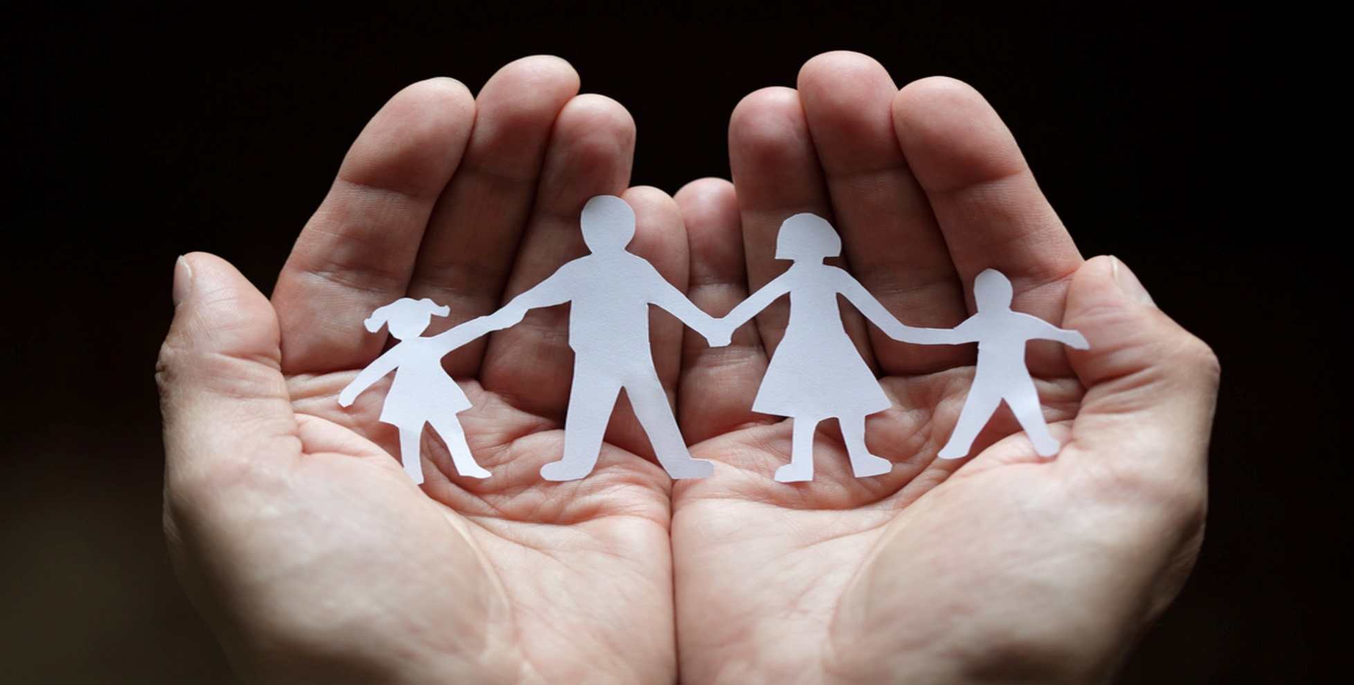
III.1. PRIMARY AND SECONDARY GROUPS
Primary groups are small and characterized by close, personal relationships that last a long time.
primary groups are marked by concern for one another, shared activities and culture, and long periods of time spent together. They are psychologically comforting and quite influential in developing personal identity;
families and close friends are examples of primary groups;
the goal of primary groups is actually the relationships themselves rather than achieving some other purpose.

Slide 17
III.1. PRIMARY AND SECONDARY GROUPS
Secondary groups include impersonal, temporary relationships that are goal-oriented.
the distinction between primary and secondary groups was originally proposed by Charles Cooley. He termed them “secondary” because they generally develop later in life and are much less likely to be influential on one’s identity than primary groups;
secondary relationships involve weak emotional ties and little personal knowledge of one another. In contrast to primary groups, secondary groups don’t have the goal of maintaining and developing the relationships themselves;
include groups in which one exchanges explicit commodities, such as labor for wages, services for payments, and such. They also include university classes, athletic teams, and groups of co-workers.

Slide 18
III.2. FORMAL AND INFORMAL GROUPS
Differences between Formal and Informal Groups
The Formal Group | The Informal Group
The formal group tends to be either large or a part of a large organization; An army and a labour union is the example of formal group; A formal group always has a normative, hierarchical structure of status system; Formal group expects strict discipline from its members; These groups may follow order from their senior officers or leaders. | A group without formally stated group rules, goals or leaders is called informal group; It is a typically small; and often; casually and spontaneously formed; Interaction is based on common interests and intimate conduct; Informal groups may or may not have strong group norms, and adherence to group norms rest on personal loyalty— rather than or explicit group rules; Children's play group and gangs, as well as cliques (which might be formed within a formal organization), are examples of informal groups.

Slide 19
III.3. INGROUPS AND OUTGROUPS
In-groups are social groups to which an individual feels he or she belongs, while an individual doesn’t identify with the out-group.
In- group favoritism refers to a preference and affinity for one’s in-group over the out-group, or anyone viewed as outside the in-group;
One of the key determinants of group biases is the need to improve self-esteem. That is individuals will find a reason, no matter how insignificant, to prove to themselves why their group is superior;
Intergroup aggression is any behavior intended to harm another person, because he or she is a member of an out-group, the behavior being viewed by its targets as undesirable;
The out-group homogeneity effect is one’s perception of out-group members as more similar to one another than are in-group members (e.g., “they are alike; we are diverse”);
Prejudice is a hostile or negative attitude toward people in a distinct group, based solely on their membership within that group;
A stereotype is a generalization about a group of people in which identical characteristics are assigned to virtually all members of the group, regardless of actual variation among the members.

Slide 20
III.4. AUTOCRATIC AND DEMOCRATIC GROUPS
Differences between Autocratic and Democratic Groups
Autocratic Groups | Democratic Groups
The role of the individual is minimum as the leader is the fountain head of all responsibilities; The autocrat is very rigid and believes that praise will improve the members efficiency and loyalty in group; Leader of the group dominates all members of the group; The members depend upon the leader for all decisions and demonstrate a slow regression to more submission, dependency and inability to take responsibility. | In democratic group the individual member has more responsibility and more scope for active participation in the functions of the group; In such a group every member is allotted some responsibility, some power, for which he feels great and involved; Different members know each other directly as the group members have link with each other; Group members are encouraged to share ideas and opinions, even though the leader retains the final say over decisions; Members of the group feel more engaged in the process; Creativity is encouraged and rewarded.

Slide 21
III.5. FACE TO FACE AND CO-ACTING GROUPS
Face-to-face group refers to social term for a small group of people in close enough physical proximity for each person in the group to interact directly with each of the others. Such a group is usually no more than six to eight people.
Co-acting group is the sociological term for people who share the same goal but work towards it without communicating or interacting.

Slide 22
III.6. MEMBERSHIP AND REFERENCE GROUPS
The Membership Groups is a process which usually either informally or formally accepts members into its ranks granting them membership. Groups such as this include- societies, clubs, teams, cliques and political parties.
Those groups to which a person actually belongs informally or formally is designated as his membership group. Ordinarily his attitudes, identifications and subsequently his diverse and specific reactions are regulated and determined by such membership groups.

Slide 23
III.6. MEMBERSHIP AND REFERENCE GROUPS
A reference group includes individuals or groups that influence our opinions, beliefs, attitudes and behaviors. They often serve as our role models and inspiration. Marketers view reference groups as important because they influence how consumers interpret information and make purchasing decisions. Reference groups influence what types of products you will purchase and which brand of product you choose.
Types of Reference Groups:
A normative reference group influences your norms, attitudes, and values through direct interaction. Examples of your normative reference groups include your parents, siblings, teachers, peers, associates and friends.
A comparative reference group is a group of individuals whom you compare yourself against and may strive to be like. Examples include celebrities and heroes.

Slide 24
IV. School Group
The class of students is a formal, institutionalized working group;
The cohesion of the students' class is an objective of the teacher's work;

Slide 25
IV.1. School Climate
School climate refers to the quality and character of school life as it relates to norms and values, interpersonal relations and social interactions, and organizational processes and structures.
School climate sets the tone for all the learning and teaching done in the school environment and it is predictive of students’ ability to learn and develop in healthy ways.
School climate directly impacts important indicators of success such as increased teacher retention, lower dropout rates, decreased incidences of violence, and higher student achievement.

Slide 26
IV.1. School Climate
The favorable psychological climate contributes
to:
raising the level of intelligence of team members;
the development of positive character traits such as: kindness, generosity, mutual help, collectivism, etc .;
developing creativity;
creating the conditions for the emergence, development and implementation of ideas.

Slide 27
IV.2. THE ROLE OF THE TEACHER IN A GROUP
The person called to shape each student individually and the entire student group is the teacher. The teacher creates the environment in which the group of students is created and developed. This ambiance deeply shapes both the quality of the group experience and the quality of the individual experience.

Slide 28
IV.2. THE ROLE OF THE TEACHER IN A GROUP CLIMATE
A teacher must:
be a good specialist who has methodical knowledge and interactive work techniques;
to be creative and energetic, passionate about his work;
to be orderly, demanding, polite, persevering, but also tolerant, empathetic, assertive;
to love children, giving them love, warmth and security;
to emanate positive energy;
to develop student-student and student-teacher relationships, etc.

Slide 29
IV.2. THE ROLE OF THE TEACHER IN A GROUP CLIMATE
An emotionally intelligent teacher is aware of his own emotions and masters them rationally, is optimistic, empathetic, has the skills to establish positive relationships, cooperation and collaboration with others, conflict resolution, can manage images, which he projects externally. If an intelligent person is perceived as cold, expressionless, unfriendly, then a rational intelligent person is sociable, cheerful, nice, pleasant and casual.

Slide 30
IV.2. THE ROLE OF THE TEACHER IN A GROUP CLIMATE
A teacher with a high level of emotional
intelligence:
is optimistic, but realistic, when necessary it can be pessimistic;
expresses emotions without fear, starting with the phrase: “I feel…”;
easily "reads" the non-verbal elements of communication;
uses balanced feelings, reason, logic and reality;

Slide 31
IV.2. THE ROLE OF THE TEACHER IN A GROUP CLIMATE
negative feelings such as fear, shame, shyness, victimization, addiction, discouragement are foreign;
is independent, with a strong morale;
possesses intrinsic motivation;
acts out of desire and not out of duty or obligation;
is guided by the own feelings, but takes into account the feelings of those around, etc.

Slide 32
Teamwork Skills
ERASMUS + 2019-1-PL01- KA201-06486
Asociatia Centrul de Training European - CTE

Slide 33
I. DEFINITION
What is Teamwork?
Teamwork is a set of actions done by a group having a common purpose or goal. Teamwork is generally fulfilled under a collaborative environment since there is the assumption that working together produces a better outcome than making separated efforts.

Slide 34
I. DEFINITION
What are teamwork skills?
Teamwork skills are the qualities and abilities that allow you to work well with others during conversations, projects, meetings or other collaborations. Having teamwork skills is dependent on your ability to communicate well, actively listen and be responsible and honest.

Slide 35
II. The meaning of Teamwork Skills
Working well in a team means:
Working with a group of people to achieve a shared goal or outcome in an effective way;
Listening to other members of the team;
Taking everyone’s ideas on board, not just your own;
Working for the good of the group as a whole;
Having a say and sharing responsibility.

Slide 36
II. The meaning of Teamwork Skills
A successful team is one where everyone’s unique skills and strengths help the team achieve a shared goal in the most effective way.
If you have good people skills you’ll make a good team player, and skills like communication and having a positive attitude make a team great.

Slide 37
III. Why are teamwork skills important?
Teamwork is vital if you want to work well with colleagues,with your class or your teammates. You will probably need to work as part of a team in many areas of life.
The better you work with others, the more successful your team will be in achieving your goals. Colleagues often need to collaborate or work with others to complete tasks and projects - teamwork skills and experience will make it a much better experience.

Slide 38
IV. Essential teamwork skills
Communication
Communication is the foundation of effective teamwork. Whether you’re working on a presentation with your class or spearheading a new project at work, it’s important to talk openly and honestly with your group members about expectations, deadlines, and responsibilities. Establishing open lines of communication promotes trust and makes for a positive team environment. While disagreements might occur, being upfront and respectful in your communication with other team members will help you resolve issues quickly.

Slide 39
IV. Essential teamwork skills
Effective communicators:
can explain their own ideas;
express their feelings in an open but non-threatening way;
listen carefully to others;
ask questions to clarify others’ ideas and emotions;
can sense how others feel based on their nonverbal communication;
will initiate conversations about group climate;
reflect on the activities and interactions of their group and encourage other group members to do so as well.

Slide 40
IV. Essential teamwork skills
Time management
Time management, accountability and responsibility are all equally important for your career as they are in your academic life. Project managers, for example, must have strong organizational skills in order to set manageable goals for their team and keep others on track to meet their deadlines. Nurses must also demonstrate strong time management skills, prioritizing and delegating tasks so that they can spend more time on the patients who need extra care.

Slide 41
IV. Essential teamwork skills
Problem-solving
Effective problem solvers are able to think outside the box when challenges or issues arise. Rather than focusing on negative outcomes, they stay calm and help their team work towards a solution. This approach helps uncover roadblocks or inefficiencies that are inhibiting the team’s success, so you can work to improve those processes in the future.

Slide 42
IV. Essential teamwork skills
Listening
When working in a group, it’s important to keep an open mind. Recognize that your team members may see things from another perspective, and hear them out. Listening to other points of view can help you see multiple sides of an issue, including ones that you have never considered before. This allows you to be a better colleague and leader, to anticipate needs and challenges before they arise and to respond effectively when they do.

Slide 43
IV. Essential teamwork skills
Critical thinking
Critical thinking allows you to make better, more informed decisions. It can be tempting to follow along with whatever the group decides, or what one team member believes is the best course of action, but sometimes a different approach or a new idea can help achieve better results. By thinking critically about the situation – examining all sides of an issue, reflecting on past experiences, and listening to what other group members have to say – you could arrive at a breakthrough that moves your team forward in new and exciting ways.

Slide 44
IV. Essential teamwork skills
Collaboration
Working in a team can be challenging at times, but more often it is a great opportunity to uncover creative ideas, share different perspectives and experiences, as well as enhance your own skills. If you treat each group project as a learning experience, you can help foster a more productive team environment. Your desire to learn and your willingness to explore new approaches will make you a better teacher, manager, or leader.

Slide 45
IV. Essential teamwork skills
Honesty
Practicing honesty and transparency might mean working through a disagreement, explaining that you were not able to complete a certain task on time or sharing difficult updates. Without transparency, it can be difficult for a team to develop trust and therefore work together efficiently.

Slide 46
V. Skills for a healthy group climate
Openness
Group members are willing to get to know one another, particularly those with different interests and backgrounds. They are open to new ideas, diverse viewpoints, and the variety of individuals present within the group. They listen to others and elicit their ideas. They know how to balance the need for cohesion within a group with the need for individual expression.

Slide 47
V. Skills for a healthy group climate
Trust and self-disclosure
Group members trust one another enough to share their own ideas and feelings. A sense of mutual trust develops only to the extent that everyone is willing to self-disclose and be honest yet respectful. Trust also grows as group members demonstrate personal accountability for the work they have been assigned.

Slide 48
V. Skills for a healthy group climate
Support
Group members demonstrate support for one another as they accomplish their goals. They exemplify a sense of team loyalty and both cheer on the group as a whole and help members who are experiencing difficulties. They view one another not as competitors but as collaborators.

Slide 49
V. Skills for a healthy group climate
Respect and Constructive Feedback
Group members communicate their opinions in a way that respects others, focusing on “What can we learn?” rather than “Who is to blame?”
Group members are able to give and receive feedback about group ideas. Giving constructive feedback requires focusing on ideas and behaviours, instead of individuals, being as positive as possible, and offering suggestions for improvement. Receiving feedback requires listening well, asking for clarification if the comment is unclear, and being open to change and other ideas.

Slide 50
VI. SKILLS FOR A SUCCESSFUL TEACHER
Teachers have the ability to change lives and develop well-educated and respectable students; they can help with not only knowledge growth but personal improvement, too. It’s an incredibly rewarding career path!

Slide 51
VI. SKILLS FOR A SUCCESSFUL TEACHER
1. Enthusiasm
A great teacher is enthusiastic about their job and lesson, and encourages students to share the same passion as they do. Think back to your favourite teacher at school – was this person always upbeat and entertaining? You need to possess that same excitement for your class!
2. Leadership
An effective teacher has the ability to lead and guide the classroom; can manage a number of different personalities, including misbehaving children, and steer them into the right direction. Leads by example and is an important role model in the students’ lives.

Slide 52
VI. SKILLS FOR A SUCCESSFUL TEACHER
3. Organisation
Teachers have to juggle a number of tasks, from lesson planning to activities and marking. In order to succeed in their role, they are required to have exceptional organisation skills. They need to be able to keep on top of these tasks and complete their duties in a timely manner.
4. Respectful
A good teacher sets a respectful tone in the classroom. Students feel safe to share their values and opinions, and their classmates have learnt to be good listeners and respect others’ thoughts. Essentially, the educator has created a useful learning environment for her pupils.

Slide 53
VI. SKILLS FOR A SUCCESSFUL TEACHER
5. Multitasking
Teaching is not only about following the curriculum and marking exams; it’s also about multitasking. A good teacher needs to have eyes on the back of the head and should be able to monitor all the pupils’ behaviour and keep their attention while completing the class. After the class, teacher need to plan following week, as well as create and mark tests and assignments.
6. Teamwork
Part of being a teacher is the ability to work as part of a team, as well as alone. They’ll need to make their students feel like they are part of a team to enhance the learning experience. Furthermore, they must network with fellow teachers to solve problems and create plans regarding the overall teaching scheme.

Slide 54
VI. SKILLS FOR A SUCCESSFUL TEACHER
7. Ability to Teach
This is a given, but being a teacher is not just about the credentials you hold to educate others. You’ll need to have instructive skills, your own style of teaching and the ability to explain and demonstrate clearly so that concepts that are not easy to understand are simplified using memorable examples or props.
8. Communication
Teachers must have remarkable communication abilities. They must be able to interact with people of all ages, including colleagues, pupils, parents and managers. Educators should effectively deliver information, understand the different points of view from other people and explain the rationale for the choices they make in regards to their teaching.

Slide 55
VI. SKILLS FOR A SUCCESSFUL TEACHER
9. Adaptability
Being adaptable to unforeseen situations is key; you never know what will happen in your classroom each day and you will need to handle each circumstance appropriately and come with quick solutions. For example, if one of your pupils is really sick or injures themselves, you’ll need to remain calm and come to the rescue.
10. Interpersonal Skills
Strong people skills can turn an average teacher into a successful one. An educator that is inclined towards helping others will create warm relationships that, in turn, boost learning. A pleasant teacher who has an engaging personality creates attentive and enthusiastic students. You will also be adept at handling students that may have learning difficulties or other disabilities that need special attention.

Slide 56
VI. SKILLS FOR A SUCCESSFUL TEACHER
11. Creativity
Teachers need creativity to keep students interested and engaged, especially children that are in primary school. You’ll need to find different ways to keep the class interested and attention levels high – this could be through roleplay or other fun learning activities.
12. Self-Evaluation
To develop professionally and provide quality education, you’ll constantly need to self-evaluate and reinvent yourself. You will have to push your pride aside and analyse where you have gone wrong and what can be improved within your classes.

Slide 57
VI. SKILLS FOR A SUCCESSFUL TEACHER
13. Patience
Patience is key when working with children and teenagers; they won’t all be well-behaved and you’ll need to be understanding when kids start to act out. You will also need to be patient if a pupil doesn’t comprehend what you are saying – you must discover alternative ways to explain things.
14. Emotional Intelligence
Teachers who have a high level of emotional intelligence know themselves very well and are able to feel the emotions of others (recognize, identify, understand).
These teachers are described by characteristics such as: open, resilient and optimistic.

Slide 58
VI. SKILLS FOR A SUCCESSFUL TEACHER
15. Empathy
If you are empathetic towards your students, they too will learn to handle their emotions and be compassionate towards each other. Proud to be Primary advises that building healthy social-emotional skills in your students will benefit your class, as well as future classrooms. Classes cannot function well if classroom community standards aren’t discussed and encouraged.
16. Critical Thinking
Teachers need to solve a number of different problems, often on a tight deadline. This frequently involves, answering difficult questions on the spot, solving conflicts, creating new lesson plans, teaching games and dealing with other personal issues between pupils or colleagues.

Slide 59
VI. SKILLS FOR A SUCCESSFUL TEACHER
17. Confidence
You can’t be a teacher if you don’t have the confidence to stand at the front of the classroom and talk to your students. You have to be a strong character that can answer questions positively and instil the same self-assurance within your classroom.
18. Commitment
You can’t stroll into your classroom when you feel like it and take a personal day because you just can’t be bothered. If you want to be a good educator, you must be committed to your job and your classroom. You need to have the passion to teach and change your pupils’ lives for the better.

Slide 60
VI. SKILLS FOR A SUCCESSFUL TEACHER
19. A Sense of Humour
This isn’t strictly a skill; you either have a sense of humour or you don’t – but having one is super useful if you want to engage with your students. You should be able to have a laugh with them and make the lesson as fun as possible – and students that are happy tend to be more open to learning!
20. Approachableness
Being approachable is a vital quality to have. Your students need to feel comfortable to ask you questions and to talk to you if they have an issue. They shouldn’t be afraid of failure or saying the wrong thing. Great teachers have warming characters that invite children to open up and get involved in the lesson.

Slide 61
Get involved and be an inspiration for your students!

Slide 62
Identifying the problems in group functioning
ERASMUS + 2019-1-PL01- KA201-06486
Asociatia Centrul de Training European - CTE

Slide 63
Inside of a group
I. Group climate & cohesion
II. Problems in group functioning
III. Bullying – a new challenge for this decade

Slide 64
I. Group climate
typically refers to “the general emotional atmosphere of the group” (McClendon & Burlingame, 2011, p. 165)
the relative degree of acceptance, tolerance, and freedom of expression that characterizes the relationships within a counseling or therapy group.

Slide 65
II. Group COHESION
The ability of a group to be more or less cohesive is dependent on several factors.
Some important factors that have been found to impact group cohesiveness:
Similarity, Group Openness to New Members, Trust, Stage of the Group

Slide 66
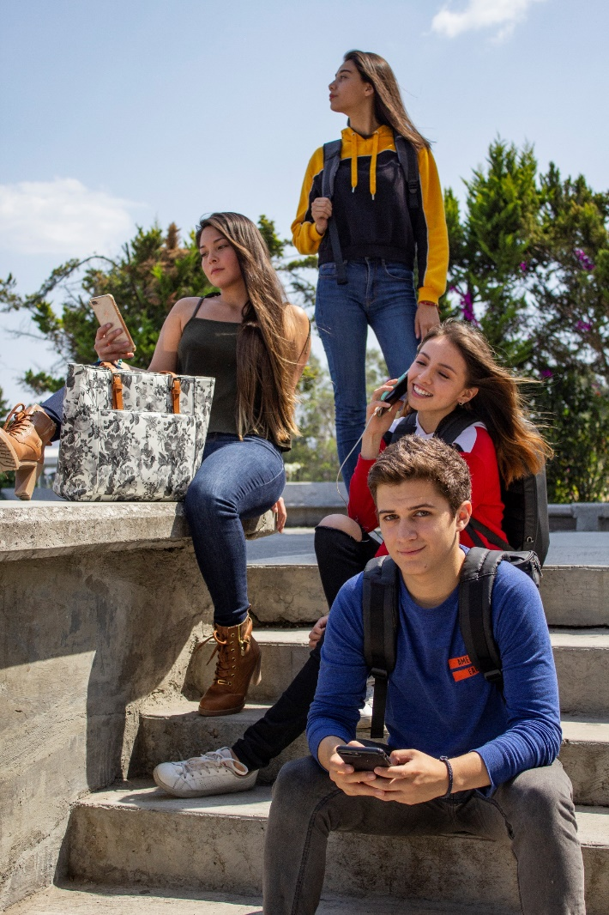
II.1. Similarity
When the group members are similar, it's easier for the group to become cohesive.
The similarity can be due to several factors, such as having similar values, beliefs, life circumstances, or pressing life issues.

Slide 67
II.2. Group Openness to New Members
When a group is open and welcoming to new members, group members more easily develop cohesion.
Often over time, group membership will change due to various life circumstances or changing individual needs.

Slide 68
II.3. Trust
When group members feel they can trust each other, group cohesiveness is more easily developed.
Example: A veteran shares with his PTSD support group things he did in Iraq for which he feels guilty. The other veterans in the group provide reassurance and don't judge him.

Slide 69
II.4. Stage of the Group
When a new group forms, there tends to be an initial burst in group cohesiveness because the first goal of any group is often to form.

Slide 70
Ii.4.4. Group dynamics
Group dynamics can be understood as how team member’s distinct roles and behaviours impact other group members and the group as a whole.
Team dynamics are therefore the unconscious, psychological factors that influence the direction of a team’s behaviour and performance.

Slide 71
Ii.4.4. Group dynamics
A team with positive group dynamics tend to have team members who trust each other. They can work towards collective decisions and they are held accountable for outcomes.
A team with good group dynamics may be constructive and productive, and it may demonstrate mutual understanding and self-corrective behaviour.

Slide 72
Ii.4.4. Group dynamics
Group dynamics matter because they impact things like creativity, productivity and effectiveness.
Since group work is integral to organisations, for business leaders, addressing group dynamics can lead to better work outcomes, customer satisfaction and an improved bottom line.

Slide 73
III. Problems in group functioning
There are some common issues that may arise when working in a group:
Poor communication
Personal issues
Unequal contribution
Lacking focus
Missing deadlines

Slide 74
III.1. Poor communication
Sometimes, your group may misunderstand each other or communicate negatively. This can lead to group members:
making assumptions
misinterpreting what's being discussed
not understanding what they need to do
working on the wrong task
failing to work well together

Slide 75
III.2. Personal issues
Problems may arise when personalities clash, or if group members start to argue with or speak over the top of each other.

Slide 76
III.3. Unequal contribution
Some group members may be quieter than others, but if members are not contributing at all this is a problem.
Try to find out why they're not participating – but don't be confrontational.
Remember to reassure all members that their opinions are valid.

Slide 77
III.4. Lacking focus
If your group is struggling to focus on their work, ask everyone to talk through the tasks they are trying to complete.
When they've explained their tasks, have the group discuss ideas for how to finish them.

Slide 78
III.5. Missing deadlines
Make sure you discuss tasks with your group and establish firm (and realistic) deadlines for completing those tasks.
All group members should agree on these deadlines before you start work.

Slide 79
III.6. Other problems
Lack of trust
Not sharing information
Lack of transparency
No long-term thinking
Not going in the same direction
Too Many Members/Groupthink

Slide 80
WHAT IS Bullying?
Bullying is an ongoing and deliberate misuse of power in relationships through repeated verbal, physical and/or social behaviour that intends to cause physical, social and/or psychological harm.
It can involve an individual or a group misusing their power, or perceived power, over one or more persons who feel unable to stop it from happening. A behavior to be considered bullying needs meet some requirements:
malintent
imbalance of power
repeatedness
distress
provocation

Slide 81
Bullying - Statistics
1. More than one out of five students report being bullied in their life
2. Bullied students reported that bullying occurred in the following places:
42% in the hallway or stairwell at school
34% inside the classroom
22% in the cafeteria
19% outside on school grounds
10% on the school bus
9% in the bathroom or locker room

Slide 82
Bullying - Statistics
3. The reasons for being bullied reported most often by students include:
Physical appearance
Race/ethnicity
Gender
Disability
Religion
Sexual orientation
4. School-based bullying prevention programs decrease bullying by up to 25%
Source: https://www.uopeople.edu/blog/definition-of-bullying/

Slide 83
Bullying - Statistics
According to UNICEF, more than one in three students aged 13-15 experience bullying, and about the same proportion are involved in physical fights.
16.1% of bullied children have experienced physical bullying, and 11.2% have experienced sexual bullying.
In 39 industrialized countries, 17 million young adolescents admitted to bullying others at school.
Victims of cyber bullying often do not report their victimization and are eight times more likely to carry a weapon to school.

Slide 84
Types of Bullying
1
2
SOCIAL
EMOTIONAL
3
CYBER
BULLYING
VERBAL
5
4
PHYSICAL
SEXUAL

Slide 85
1. EMOTIONAL Bullying
Social bullying, sometimes referred to as relational bullying, involves hurting someone’s reputation or relationships. Social bullying includes:
Leaving someone out on purpose
Telling other children not to be friends with someone
Spreading rumors about someone
Embarrassing someone in public

Slide 86
2. SOCIAL Bullying
Social bullying, sometimes referred to as relational bullying, involves hurting someone’s reputation or relationships. Social bullying includes:
Leaving someone out on purpose
Telling other children not to be friends with someone
Spreading rumors about someone
Embarrassing someone in public

Slide 87
3. VERBAL Bullying
Verbal bullying includes:
Teasing
Name-calling
Inappropriate sexual comments
Taunting
Threatening to cause harm

Slide 88
4. PHYSICAL BULLYING
Physical bullying involves hurting a person’s body or possessions. Physical bullying includes:
Hitting/kicking/pinching
Spitting
Tripping/pushing
Taking or breaking someone’s things
Making mean or rude hand gestures

Slide 89
5. CYBERBULLYING
Cyberbullying is any type of bullying that happens online. It can be hurtful comments on a personal site or deceptive private messaging.
Involves using electronics to harm others. This type of bullying can be especially harmful because the perpetrators are more difficult to identify, it can more quickly and impulsively be spread to larger audiences, and the physical evidence of the bullying cannot be easily erased from cyberspace. Victims of cyber bullying are often also victims of traditional off-line bullying.

Slide 90
Check if you have problems in group
We don’t listen to each other.
We keep repeating arguments instead of moving on.
We constantly interrupt each other.

Slide 91
Check if you have problems in group
We just push our own views instead of developing and encouraging other's ideas.
We allow dominant members to dominate.
Some of us don’t contribute.
We don’t compromise enough.

Slide 92
Check if you have problems in group
We concentrate on making impressions rather than getting the job done.
We don’t have clear tasks or objectives.
We are not clear about what has been decided.

Slide 93
Get involved and be an inspiration for your students!

Slide 94
Discovering the possible ways of solving the conflict
ERASMUS + 2019-1-PL01- KA201-06486
Asociatia Centrul de Training European - CTE

Slide 95
Content
Sources of conflict in groups
Conflict management

Slide 96
In order to avoid conflicts ensure that all the members of the group know the the mission, vision, and goals of the team

Slide 97
I. Sources of conflict in groups
Styles of Conflict Management:
integrating (high concern for self and others)
dominating (low concern for others)
obliging (low concern for self)
avoiding (low concern for self and others)
compromising (moderate levels for both)

Slide 98
A. FIVE STAGES OF CONFLICT
Stage | Description
Latent Stage | Participants not yet aware of conflict
Perceived Stage | Participants aware a conflict exists
Felt Stage | Stress and anxiety
Manifest | Conflict is open and can be observed
Aftermath | Outcome of conflict, resolution or dissolution

Slide 99
c. Strategies to Resolve Conflict in groups
Embrace conflict
Talk together
Listen carefully
Find agreement
Provide guidance
Be quick to forgive

Slide 100
1. Embrace conflict
don`t avoid the conflict or pretend that nothing happened
deal with these uncomfortable issues as soon as possible
address it head on and in private

Slide 101
2. Talk together
- set a time and place to talk about the disagreements
- try to have enough time for each member of the group and don't let any individual monopolize the conversation

Slide 102
3. Listen carefully
it's essential to give your complete attention to the person who is talking
rephrase and repeat back what you've heard to confirm understanding
ask clarifying questions if needed

Slide 103
4. Find agreement
find points of agreement
shed light on commonalities
share examples or instances in which you agree with the other person or can see another point of view

Slide 104
5. Provide guidance
don’t take sides
guide the conversation
highlight the positive aspects of the process and suggest related topics or actions

Slide 105
6. Be quick to forgive
apologize
forgive the other person
tell the other person you're truly sorry for any ill words or actions -and mean it

Slide 106
d. Types of Conflict and How to Address Them
Task Conflict
Relationship Conflict
Value Conflict

Slide 107
1. Task Conflict
involves concrete issues related to group member`s assignments and can include disputes about how to divide up resources
is the simplest to resolve
ask conflict often benefits from the intervention of an group’s leaders

Slide 108
2. Relationship Conflict
arises from differences in personality, style, matters of taste, and even conflict styles
bring up the source of the tension and focus on listening to the other person’s point of view
resist the urge to argue or defend your position

Slide 109
3. Value Conflict
arise from fundamental differences in identities and values, which can include differences in politics, religion, ethics, norms, and other deeply held beliefs
disputes involving values tend to heighten defensiveness, distrust, and alienation
move beyond demonization toward mutual understanding and respect through dialogue

Slide 110
common issues in groups
Poor communication
Personal issues
Unequal contribution
Lacking focus
Missing deadlines

Slide 111
II. Conflict management How do we solve them?

Slide 112
Poor communication
clarify anything they don't understand
ask questions instead of making accusations
1.
make requests instead of demands
express their views as opinions instead of facts
2.
provide constructive criticism
speak respectfully and positively
3.

Slide 113
Tips & Tricks
Instead of saying "You're wrong" say "I don't think I agree with that because...".
Instead of saying "You're being lazy" say "You don't seem to be contributing to the group. Is there a problem?".
Instead of saying "You should do it this way" say "It might help if we do it this way.".

Slide 114
Personal issues
Arises when 2 different types of personalities clash:
Conflict between members
Domineering personalities

Slide 115
Conflict between members
respect and acknowledge others' ideas
consider how they can improve their communication
1.
work through the cause of the conflict as a group
understand that working in a team may require negotiation and compromise
2.

Slide 116
Domineering personalities
create time limits for individual contributions
1.
ensure that each member has a chance to speak without interruption
2.
remind all members that it's important to hear all opinions about the topic and respect those opinions
3.

Slide 117
Unequal contribution
Remember to reassure all members that their opinions are valid
Try to find out why they're not participating
Some group members may be quieter than others

Slide 118
Tips & Tricks
brainstorm the topic as a group
1.
research the topic independently and then meet to discuss the group's findings
2.
ask everyone to contribute with their ideas
3.

Slide 119
Lacking focus
setting meeting goals
1.
working through complex tasks as a group
2.
rewarding the group for staying on task (e.g. organise a lunch or another activity)
3.

Slide 120
Missing deadlines
Make sure you discuss tasks with your group
establish firm (and realistic) deadlines
adjust deadlines if needed

Slide 121
MEASURES TO AVOID BULLYING
1. Establish a safe and positive School Climate
each member of the group will feel safe, encouraged and appreciated and the negative behavior will decrease
a good climate in the classroom can be established by:
Teach Kindness and Empathy
Identify Gateway Behaviors and Warning Signs
Create Opportunities for Connections
Participate in Simulations
Set Clear, Enforceable Rules
Remove Labels, Address Behaviors
Reward Positive Behavior

Slide 122
MEASURES TO AVOID BULLYING
1. Establish a safe and positive School Climate
each member of the group will feel safe, encouraged and appreciated and the negative behavior will decrease
a good climate in the classroom can be established by:
Teach Kindness and Empathy
Identify Gateway Behaviors and Warning Signs
Create Opportunities for Connections
Participate in Simulations
Set Clear, Enforceable Rules
Remove Labels, Address Behaviors
Reward Positive Behavior

Slide 123
MEASURES TO AVOID BULLYING
2. Talk with your students and their parents about bullying
Students:
let them know which behaviours are considered bullying
ensure your students know the consequences for bullying others at school
Establish a set of rules for the group and talk about their importance
Parents:
engage parents in your bullying prevention programs & Increase awareness
Make them your partner

Slide 124
MEASURES TO AVOID BULLYING
3. Learn about the bullying indicators
- be sure you are able to recognize the most common types of bullying
look for what is called "gateway indicators." These are initial behaviors that students display:
rolling eyes
laughing under their breath
making jokes
turning their back on others
and using sarcasm

Slide 125
MEASURES TO AVOID BULLYING
4. Be visible in the areas where someone can be bullyied and respond quickly
make sure your students see you anywhere bullying might occur like the bathrooms, hallways, and even in the lunchroom
when you spot bullying, address it right away; don`t let this undiscussed or punished
keep a close eye on the situation

Slide 126
Get involved and be an inspiration for your students!

