Slide 1
STAGES OF BUILDING WORK STRATEGY WITH AN AGGRESSIVE STUDENT
ERASMUS + 2019-1-PL01- KA201-06486
Problems in relations with adults

Slide 2
What do i know about tom?
Tom is a student who cannot control his emotions. He comes from a family where parents shout at children and do not resolve conflict by a conversation. Tom has problems with communicating emotions and problems. Tom unloads his negative emotions using verbal or physical aggression.

Slide 3
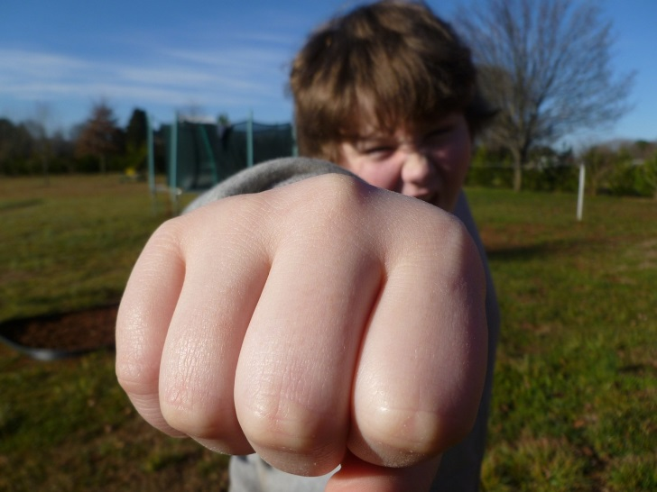
Introduction
Aggression is defined as behavior that is intended to harm another individual who does not wish to be harmed.
In school life the problem of aggression is very popular so every teacher should learn how to deal with students’ aggression.
The first step is to learn causes of an individual student’s aggression and then, to take appropriate actions to help a student deal with aggression.
A photo from pixabay.com

Slide 4
symptoms
Verbal aggression: defiance, continuous arguing, threats, swearing, bossing, sarcasm, teasing
Physical aggression: kicking, hitting, fighting, spitting, throwing things with intent to harm, biting
Vandalism: destructing or damaging things and theft, too
A photo from pixabay.com

Slide 5
Why are people aggressive?
People are aggressive:
to express anger or hostility,
to assert dominance,
to intimidate or threaten,
to achieve a goal,
to express possession,
to compete with others.
Aggression can be also a response to fear or a reaction to pain.

Slide 6
Causes (1)
There are a lot of theories that explain causes of aggression. Several of them are very important for teachers.
Modeling – children observe aggressive behaviour of their parents, teachers, peers. They imitate aggressive models of behaviour.
Peer reinforcement – when other children appreciate aggression as a way of resolving problems.

Slide 7
CaUSES (2)
Social skills deficit – children lack the social skills necassary to deal with stressfull situations in an assertive rather that aggressive way. Their repertoire of problem-solving skills is limited to aggression.
Low self-esteem – lack of love and low self-esteem can lead to frustration which is a direct cause of aggression.

Slide 8
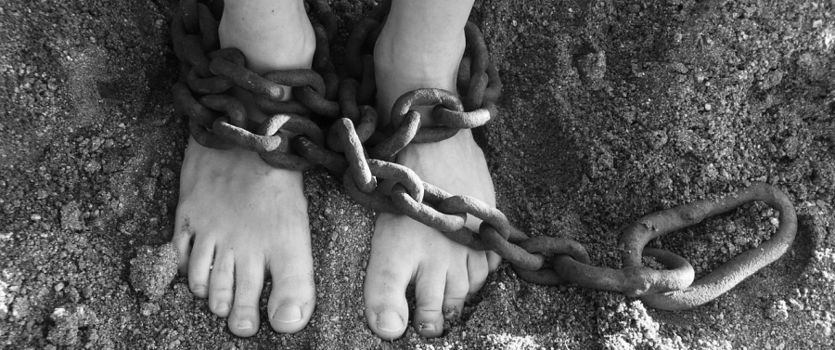
consequences
Destruction of peer relationships.
Isolation of an aggressive student.
Problems in student-teacher relations.
Probability that an aggressive student will join a pathological group.
Negative reactions in victims of aggression (lack of self-confidence, stress and fear, aversion to school, truancy, stomach ache, sleep disturbance, etc.).
Aggression in other people (aggression leads to aggression).
A photo from pixabay.com

Slide 9
Ineffective response (1)
Teacher, here is what you should never do:
Enforce a consequence immediately – of course, you must call a student to account but not immediately. You risk escalating the problem if you immediately try to discuss with him.
Get angry – aggresion on aggression is an explosive mix.Never yell or attempt to use the power of your authority to stop emotionally charged students.

Slide 10
INEFFECTIVE RESPONSE (2)
Touch the student – it is often for teachers to put a hand on a student’s shoulder to calm him. But you do not know what students are thinking and what will they react. It is better to keep the distance.
Talk with the student immediately – angry students are not open to conversation. Give them some time, leve them alone.Talk to them after a few hours.

Slide 11
Effective response (1)
Here is what you should do:
Stay calm – controling your emotions is a first step to control the situation.
Shield other students – do not let other students be involved with the angry student. It is your priority to keep them safe and calm.
Calm the student – you might have to use calming language and reassurance to settle the student down. Say: “Take it easy… I know you’re frustrated… We’ll talk about it later…”

Slide 12
EFFECTIVE RESPONSE (2)
Wait – do not speak to the angry student until he is in a calm emotional state. Continue with your day until you know the student is ready to listen.
Hold accountable - after the student returns to a calm frame of mind briefly explain how he will be held accountable.
Provide a stiff consequence - acting out in anger should result in consequences. It can be a full day in-class separation from the rest of the students, etc.

Slide 13
STAGES OF BUILDING WORK STRATEGY WITH A STUDENT WITH NO WILL TO COOPERATE
ERASMUS + 2019-1-PL01- KA201-06486
Problems in relations with adults

Slide 14
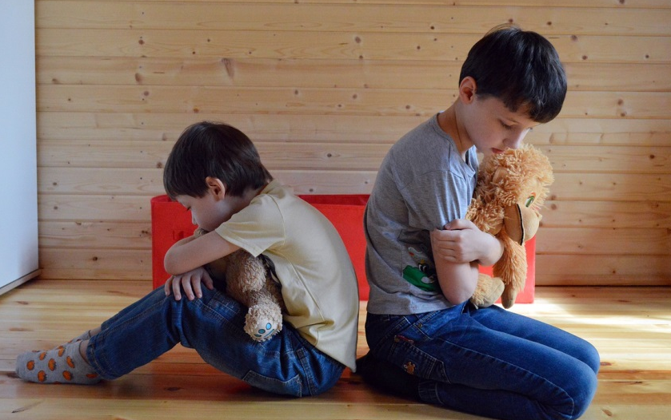
InTRODUCTION
No will to cooperate can have various forms and it can be caused by various problems.
The teacher’s role is to recognize the problem (its causes, feelings of a student, family situation, peer relationships, etc.) and help a student work out ways to deal with the problem.
This work needs a lot of intuition, delicateness, and mindfulness.
A photo from pixabay.com

Slide 15
SYMPTOMS (1)
A student does not want to follow the teacher’s instructions. He refuses doing tasks or he just pretends that he does them.
A student does not want to do tasks during the lesson. He does not want to read the text, does not want to take the quiz, he does not want to write down in a notebook.
A student is not interested in building communication with the teacher. He does not want to answer questions, he refuses a proposition to talk about problems. He also does not tell about himself.

Slide 16
SYMPTOMS (2)
A student skips classes. It can mean that a child does not see a value of the class. Skipping can also be an effect of stress connected with difficult tasks, a feeling of being misunderstood.
A student shows a disparaging attitude to school, learning and teachers. He can comment tasks as “stupid” or “needless”. He can also deride other students who are diligent and hardworking.

Slide 17
CAUSES (1)
A student does not like school. It can be an effect of various factors. The environment of a student’s life could have taught him that a school is boring and that learning does not have any sense. When parents does not treat school and learning as an important thing, a child repossesses this conviction.
A teacher gives too high requirements to a student. A child cannot manage and after a few times he starts thinking that the tasks are impossible to be done correctly. It can lead to frustration which can be exhibited towards a teacher.
A picture from pixabay.com

Slide 18
CAUSES (2)
A teacher has no will to cooperate with students. He treats his job not as a service and relation with students but just as a duty. He does not like students which show difficult attitudes and he has no patience to work with such students.
A student has other difficulties which are not seen by a teacher. For example, it can be a dyslexia. The tasks are not accommodated to a student’s dysfunction and he has big problems with meeting the demands. It can lead to a thought that a teacher does not understand students and that no cooperation is possible. It also can lead to frustration and no will to cooperate.
A picture from pixabay.com

Slide 19
CONSEQUENCES
A student does not do the tasks correctly. He makes a lot of mistakes in exercises and his works are not solid enough.
A student is not prepared for classes.
A student is more and more annoyed because he feels that a teacher does not understand him and his problem.
A student’s talents and skills are hidden and cannot be seen by a teacher.
A student can have problems in future life (problems in learning can lead to problems in finding a good job; lack of communication skills can also complicate teamwork).

Slide 20
Teacher! What should you do? (1)
Create a relationship with a student. Let him know that you want to help him.
Try to elaborate in a student openess and feeling of being accepted.
Help a student change his negative attitude to learning at schol. Make lessons interesting, show the advantages of learning.
Change student’s motivation to learning (building an internal motivation).
A picture from pixabay.com

Slide 21
Teacher! What should you do? (2)
Increase of parents’ engagement in motivating a child to learning.
Elaborate consistence in student’s compliance with the rules.
Improve quality of transferring the subject of a lesson (yes! sometimes lessons are just boring!).
A photo from pixabay.com

Slide 22
STAGES OF BUILDING WORK STRATEGY WITH A MANIPULATIVE STUDENT
ERASMUS + 2019-1-PL01- KA201-06486
Problems in relations with adults

Slide 23
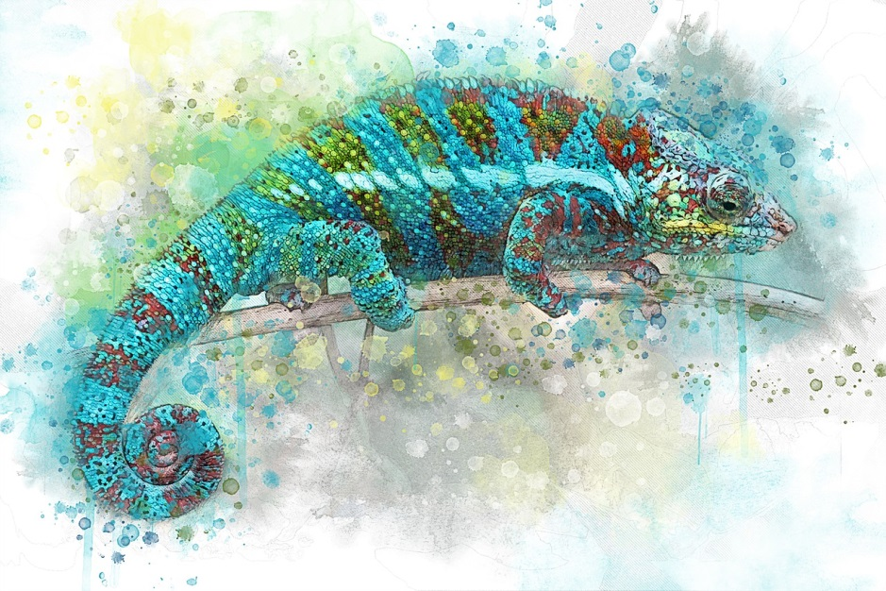
Introduction
Manipulation is the practice of using indirect tactics to control behavior, emotions, and relationships.
Manipulation is an emotionally unhealthy psychological strategy used by people who are incapable of asking for what they want and need in a direct way.
Manipulation is used by adults (e.g. in their work or family life) but also by children.
A picture from pixabay.com

Slide 24
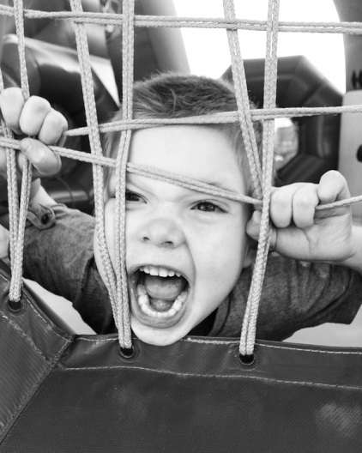
SYMPTOMS (1)
A student pretends he cannot do the given task. The purpose of such an action can be to convince a teacher to do the task instead of a child.
A student pretends he does not believe in himself and his value. He do it to get compassion and pity and gain lower requirements.
A student tries to sidetrack a teacher by changing topics, finding other problems, asking questions, etc.
A picture from pixabay.com

Slide 25
SYMPTOMS (2)
A student tries to convince a teacher that someone else is responsible for his behaviour/ mistakes/ emotions. For example, he blames teacher that he cannot teach well or parents who did not give him time to do the homework.
A student pays a lot of compliments towards a teacher.
A student blackmails a teacher or other students.
A picture from pixabay.com

Slide 26
CAUSES (1)
The most popular cause: a student has a wrong model of behaviour. He usually takes it from home (e.g. parents uses manipulation toward him).
A picture from pixabay.com
A student has no limits given by his parents. When parents cannot be assertive, a child makes use of their weakness and treats manipulation as one of the best methods to get what he wants.
A student does not feel accepted and he tries to catch people’s attention on him.

Slide 27
CAUSES (2)
A student has a big need for a sense of control. It can be caused by a low sense of security which can cause attempts to build a world without surprises. Manipulation helps in building such a safe world.
Reduction of empathy and sensitivity to other people’s problems and pains. It can be caused by interception of models taken from the virtual world.
A student was not taught how to control himself, how to overstep some desires, which are incorrect. For example, a strong desire to be the best student in the class and to be the most famous person at school can lead a student to use manipulation to gain this aim.

Slide 28
CONSEQUENCES (1)
A student have a wrong image of human relationships. He thinks that such relations should be based on manipulation, imposing, cheating instead of being based on freedom, fairness, collaboration.
A student does not want to do his best and to develop himself because he can see that an easier and more effective way is to press someone to do the task instead of him.
A picture from pixabay.com

Slide 29
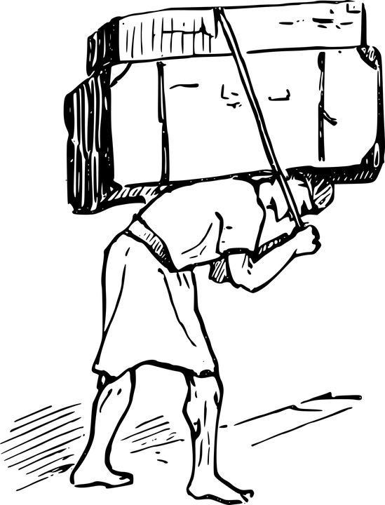
CONSEQUENCES (2)
A person who uses manipulation does not think that other people also have some aims – he treats them just as means to an end, as object which he can control. Such attitude also makes a student an egoist and a bighead.
Manipulation in childhood, when it is not stemmed, can have adverse effects in adulthood. A student in his adulthood will manipulate his relatives (a wife/ a husband, children). Because of that, his relationships will be unhealthy.
A picture from pixabay.com

Slide 30
CONSEQUENCES (3)
Manipulation can affect a student-teacher relationship. A teacher can be unwilling to work with a student who manipulate. And it can lead a student to a conviction that teachers and all adults are unkind and that they will not help him.
Students do not like manipulative friends. They do not have trust to them and feel abused. It can lead to frustration in a manipulative student.
Manipulation builds a false image of a student. A teacher cannot help him with problems because he cannot see them.
A picture from pixabay.com

Slide 31
Teacher! What should you do? (1)
Try to identify the causes of student’s manipulation. Why does he manipulate? Where did he learn it? What does he try to achieve?
Create relationships based on a sense of community and co-responsibility. Show a student that he is accepted.
Learn about manipulation. Learn how to deal with manipulation.
You can prepare a lesson about manipulation to protect students from it.
A picture from pixabay.com

Slide 32
Teacher! What should you do? (2)
Try to decrease a student’s conviction that manipulation is efficient. Set boundaries and be consistent in keeping them. Be assertive.
Show good behaviour patterns. Do not manipulate!
Talk with students about ways of solving problems in the ethical way. Show alternatives to manipulation.
Talk with parents. Explain them techniques of manipulation in children’s behaviour and give advices how to deal with manipulation.
A picture from pixabay.com

Slide 33
Teacher! What should you do? (3)
Improve students’ communication skills. Teach them how to talk about difficulties and emotions.
Show a student that an honest working on one’s weakness has higher value than gaining goals at all costs.
Use positive reinforcements – praise a student for attempts to using other ways of achieving goals than manipulation.
A picture from pixabay.com

Slide 34
STAGES OF BUILDING WORK STRATEGY WITH AN ISOLATING STUDENT
ERASMUS + 2019-1-PL01- KA201-06486
Problems in relations with adults

Slide 35
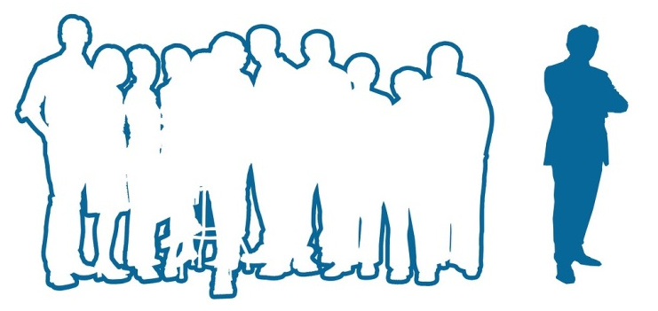
INTRODUCTION
Isolation problem is a wide topic. There are a lot of forms and causes of isolation. Not always isolation is something undesirable, sometimes it is normal and needed. But there are a lot of negative forms of isolation.
Students’ isolation is a well-known problem for teachers. It is very important to observe isolating students and try to find reasons for their isolation. It is very important to help isolating student create relationships with people.
A picture from pixabay.com

Slide 36
SYMPTOMS (1)
A student spends his time alone, not with other students. Especially it can be seen during the break.
A student does not have friends. He does not talk about other people after coming back from school, he does not meet friends.
A student does not like team work during lessons. When he is forced to work with someone else, he is isolated – does not take active part in tasks, does not talk.
A picture from pixabay.com

Slide 37
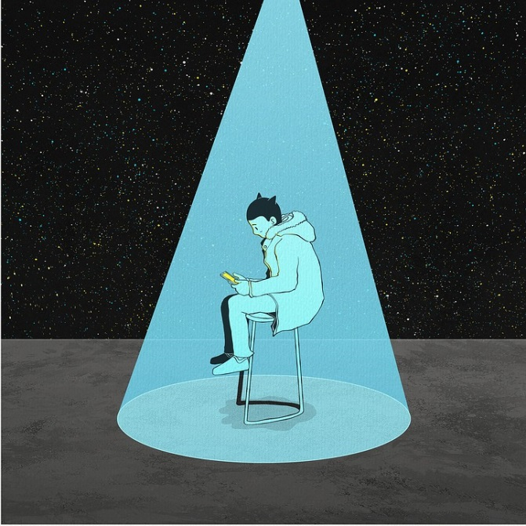
SYMPTOMS (2)
A student cannot make contact with other people. He tells about them that they are stupid or terrible, that he does not like to spend time with them.
A student tells that other children (or teachers) do not like him, that they do not understand him, they do not want to pay their attention on him or spend their time with him. He communicates that he feels strange with them, that he cannot be himself, that they do not treat him seriously, etc.
A picture from pixabay.com

Slide 38
SYMPTOMS (3)
A student is convinced about his worthless and he thinks that nobody will like him because he is not good enough, beautiful enough, funny enough, clever enough, etc. He is sad about that but he thinks that he cannot do anything with such a situation.
A student avoids school trips, parties, integration games. He also does not like team sports and has no will to take part in organizing events with other people.
A picture from pixabay.com

Slide 39
CAUSES (1)
It is important to know that the causes of problems can be connected with a particular situation or with a student’s personality. Some people are shy and introverted and they need less contact that other people. But sometimes a student’s personality does not affect his problems with building relations with people. Then causes are probably connected with some particular situations.
A student do not have communication skills – no one has taught him how to start a contact with people, how to overstep shyness and stress. The reason can be also inappropriate relationships in family and at school (difficulties in contact with teachers).

Slide 40
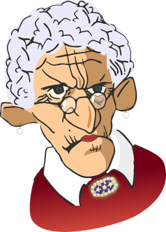
CAUSES (2)
Another cause of a student’s isolation can be incorrect behaviour of his teachers (for example, two or three teachers do not respect students or despise them – and a child can think that every teacher behaves this way).
A student has a difficult family or material situation. For example, he is ashamed of his poverty or his appearance.
A picture from pixabay.com
A picture from pixabay.com

Slide 41
CAUSES (3)
A student has too low or to high sense of self-worth. He can think that nobody would like to talk to him or treat him seriously. He can also think that he is better than other people and he do not need their company.
A student has wrong models from his family, for example, he is taught that people are always unkind and that they do not want to help him but they are hostile, malicious and ill-intentioned.
A picture from pixabay.com

Slide 42
CAUSES (4)
A student spends too much time in a virtual world of computer games, social networks, etc. It leads him to disability of making relationships with people in a real world. A student does not know how to talk especially with adults because relationship with them requires to know appropriate rules of behaviour, language etc.
Some difficult experience connected with adults, for example, a child was hurt or used by someone. The cause can be also that a child have lost someone that was very important to him and he is afraid of starting relations because he is afraid about new pain.

Slide 43
CONSEQUENCES (1)
School failure. When a student is passive during lessons, he has smaller chances to learn and get new skills. When he is too shy to ask a question, to tell that he does not understand something or just to answer the question, he looses the chance to understand things.
A lack of communicative competences which are very important in functioning in the society. A student does not practice useful skills and have no will to make contacts with other people.
A picture from pixabay.com

Slide 44
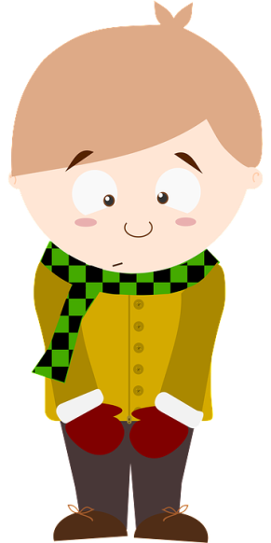
CONSEQUENCES (2)
The consequences of an isolation from the society can be personality disorders like depression, anxiety disorders etc.
A conviction about hostility of people. It leads to deeper isolation and no will to make relations and to let other people help. Such a person can think that he can rely only on himself.
A student does get a teacher’s attention because a teacher does not see any unwanted behaviour. Isolating students are often calm, shy and do not disturb lessons. So teachers do not know that they can have problems or need help because they do not develop correctly.
A picture from pixabay.com

Slide 45
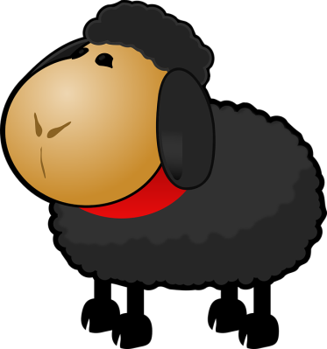
CONSEQUENCES (3)
A student can be persecuted by other children. It is because he is too shy to stand up against them or to tell a teacher about the problem. Shy children are often “a scapegoats” in a class.
A picture from pixabay.com
A student who will not overstep his problems with communication and isolation will probably become a passive adult: a passive citizen of his country and a passive parent. It can lead also to rising children which will also isolate.

Slide 46
CONSEQUENCES (4)
A student will probably have an untrue image of himself because he will not have a feedback about his character and behaviour from other people. It can lead to incorrect self-esteem: a person can have too low or too high self-esteem.
A student will not have deep relationships with other people. Relationships are very important in the integral development of a person. The lack of relationships can generate many problems according to communication, internal growth, moral development, etc.
A picture from pixabay.com

Slide 47
Teacher! What should you do? (1)
Work on the integration between a student and a class (encourage students to have contact with the isolative student; organize integration games and exercises, talk to students on how to be a good friend).
A picture from pixabay.com
Work on a good relation between you and a student (show your attention to a student; talk with a student about problems but also about hobbies, interests – show that this relationship does not need to be only formal).

Slide 48
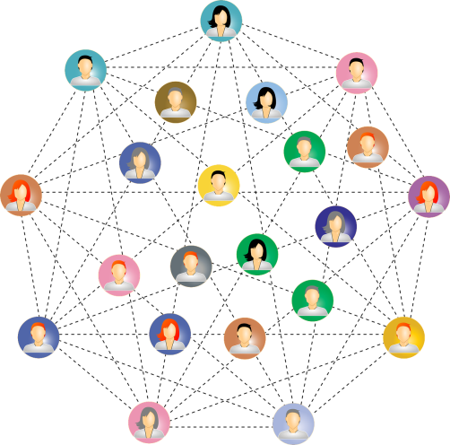
Teacher! What should you do? (2)
Develop communication skills in a student (prepare a lesson about practical tips for communication; do exercises about ommunication; ecourage children to communicate).
Encourage other children to talk and spend time with a student who isolates himself. Talk with four/five students privately – ask them to engage an isolating student in a class life.
Work on proper self-esteem in a student – build his self-confidence, but also show what he can change in his behaviour.
A picture from pixabay.com

Slide 49
Teacher! What should you do? (3)
Be kind to students and show eagerness to help in school and private difficulties.
Show the world as friendly, full of surprises, and people as good and kind. It will help a student in overstepping distrust.
Work on social activation of a student. Involve him in organizing class events and trips. Encourage him to take part in various team projects, games, etc.
A picture from pixabay.com

Slide 50
Teacher! What should you do? (4)
Form an attitude of perseverance in a student (make him aware that failures are the part of the development process; praise a student when he shows perseverance in making contact with people).
Include parents into a process of integration between a student and society (show them ideas how they can help, e.g. they can encourage a child to meet other children after school).
A picture from pixabay.com

Slide 51
STAGES OF BUILDING WORK STRATEGY WITH A STUDENT WHO FOCUSSES ATTENTION ON HIMSELF
ERASMUS + 2019-1-PL01- KA201-06486
Problems in relations with adults

Slide 52
introduction
Most often children’s attempts to focus people’s attention on them is a result of a strong need to be accepted.
It is good to know that children’s attempts to focus someone’s attention on them is not a manipulation and conscious action. Children usually do not know why they try to catch someone’s attention.
A picture from pixabay.com

Slide 53
SYMPTOMS (1)
A student is loudly and noisy. He tries to interrupt a teacher during a lesson. He interposes funny or ironic comments. He expresses his opinion about lessons, topics or about a teacher or other children.
A student looks for plaudits of other students by doing funny things or making jokes. He can also be rude towards a teacher to get other children’s attention.
A student comes late to school or plays truant.
Pictures from pixabay.com

Slide 54
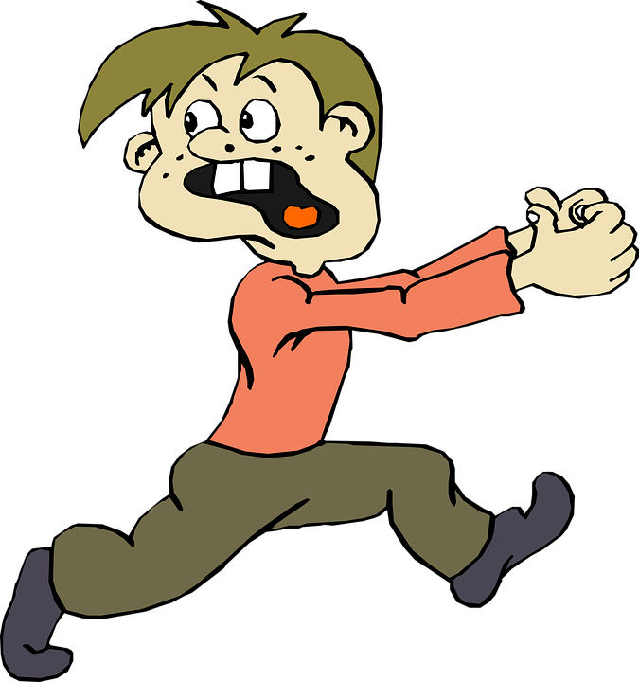
SYMPTOMS (2)
A student tries to be active all the time, he does not let other students answer questions or do some tasks. He does it even if he does not know the answer or does not know how to do the task.
A student does not respect rules, he breaks them intentionally and with no reason. He does not listen to a teacher’s injunctions and he feels no shame because of his incorrect behaviour.
A student escapes home, he is not obedient to his parents, he comes home late.
A picture from pixabay.com

Slide 55
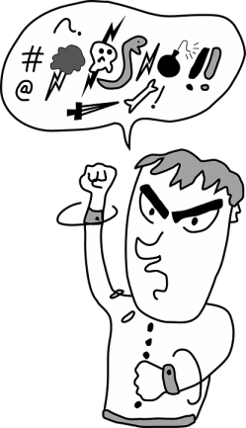
SYMPTOMS (3)
A student pretends that he cannot do tasks or exercises to get a teacher’s help and attention. He can also pretend incapacity in doing basic things because then he gets someone’s attention.
In extreme cases, a student hurts himself or other people, for example, he injures visible parts of his hands, he beats or barges other children. A student can also destroy other people’s things or school equipment.
A student uses vulgarisms.
Pictures from pixabay.com

Slide 56
CAUSES (1)
The lack of closeness in a student’s family. A student does not feel that parents love him and that he is important for them. Because of that, he starts drawing their attention. Firstly, he does it by communicating his needs (“mummy, play with me”) but when parents do not react for such needs, a child starts drawing their attention in a different way (he starts crying or shouting, he can be disobedient, noisy).
When other people’s attention is insufficient, a child can feel needless and try to show his presence in a group. For example, when other children do not want to play with him, he can start interrupting them or even offend them.
A picture from pixabay.com

Slide 57
CAUSES (2)
Teacher’s disability to show his interest in every child in a class. Sometimes teachers talk only with ambitious and capable students or with students who are disobedient and noisy. In bad behaviour a child can see a chance to draw a teacher’s attention on him.
Frustration. It can have various reasons. For example, a student has school failure and even if he learns hard, he cannot get satisfying results. The cause of frustration can be also being unseen or ignored by a teacher or other children. It is a source of a lot of negative emotions which can lead to a change in a student’s behaviour.
A picture from pixabay.com

Slide 58
CAUSES (3)
A need of acceptance. When a student is uncertain about his value, he tries to examine how other people see him. But it leads to a vicious circle: a student wants to draw someone’s attention to confirm his value but by drawing attention he gets a negative feedback (a teacher reprimands him) what leads to a conviction about the lack of value and this leads again to draw people’s attention on himself.
A picture from pixabay.com

Slide 59
CAUSES (4)
Negative emotions like a need of revenge or jealousy. A students tries to draw a teacher’s attention on himself because, for example, he see that a teacher keeps his attention on another child. A student can feel it as unfair and try to change this situation. He can also be angry with a teacher or some schoolmates and he tries to disturb lesson to make them angry.
A picture from pixabay.com

Slide 60
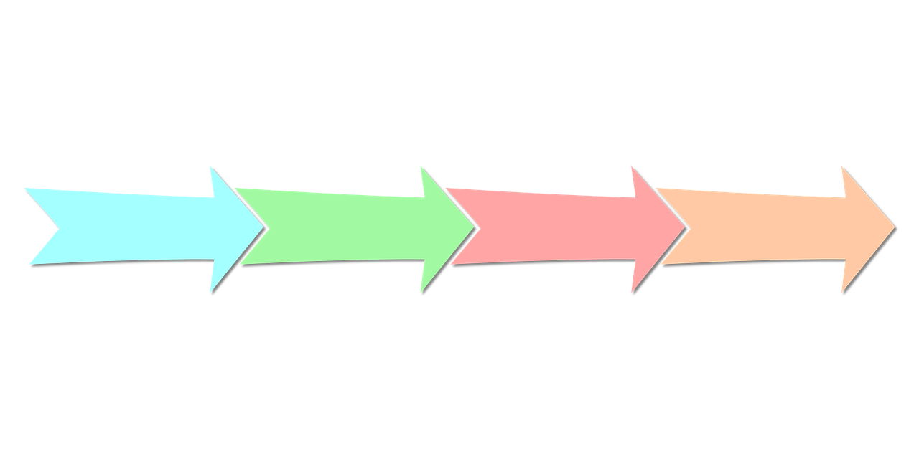
CONSEQUENCES (1)
A student who tries to draw people’s attention on himself can be turned down by other students from a peer group. It would have negative consequences for a student’s development because children and teenagers need to build relationships and learn how to function in social groups.
A strong need in a student to be in the limelight, to draw everybody’s attention only on him. A student cannot stand a situation when someone else is praised and he is jealous and unhappy when no one shows interest in him. The lack of someone’s attention leads a student to a sense of rejection and to decrease of self-esteem.
A picture from pixabay.com

Slide 61
CONSEQUENCES (2)
Teachers’ annoyance which can make teacher-student relationships worse. Teachers can try to show a student that he is not the only child in a class, they can ignore him what can result in a student’s anger and increased attempts to draw teachers’ attention.
As a consequence of attempts to draw teachers’ attention on himself by pretending that he cannot do some task and needs help, a student can become helpless and not self-reliant. When a student imposes on a teacher too much help, he cannot do basic things himself and in the future, he will also try to enforce other people to do the tasks instead of him.
A picture from pixabay.com

Slide 62
CONSEQUENCES (3)
A student who tries to focus other people’s attention on himself can become convinced that manipulation is a good way of reaching goals and that he does not need to take weak people into account. Such a student can become an egoistic adult who will impose desirable actions on other people. Such an attitude is incorrect and leads to problems in relationships in families and other human relations.
A picture from pixabay.com

Slide 63
Teacher! What should you do? (1)
Talk to a student about his behaviour. Together ask about reasons for his behaviour and make him aware of potential consequences of his behaviour.
Suggest to a student alternative behaviours in a particular situation (e.g. when he will need help, he will raise a hand and tell that he needs help).
Prepare a lesson concerning communication and its rules. Train correct communication behaviours with students by games, playing roles, etc.
A picture from pixabay.com

Slide 64
Teacher! What should you do? (2)
Help a student build self-reliance. You can do it by: giving him small tasks which he will able to complete; giving rewards for completing the task unassisted; convince a student that he can do the task himself; refuse to do the task for student (but help him find an appropriate method).
Show your interest to a student not only when he is disobedient and rude.
Help a student feel needed by giving him task to do (count children, open the window, etc.).
A picture from pixabay.com

Slide 65
Teacher! What should you do? (3)
Work on improving the relation between you and a student.
Show kindness and patience to a student. Do not show annoyance. Do not ignore a student.
Talk to a student, be interested in his life (e.g. ask about his interests, about ways of spending his free time).
Create a space to talk about difficult topics – to give a student a possibility to express what he likes, what hurts him, what he needs.
A picture from pixabay.com

Slide 66
Teacher! What should you do? (4)
Help students work out collaboration and partnership.
Use integration games.
Give tasks requiring collaboration between students.
Organize trips and spending time together.
Encourage students to build relations after school.
Assign a student to groups where students will not strengthen his negative behaviours.
A picture from pixabay.com

Slide 67
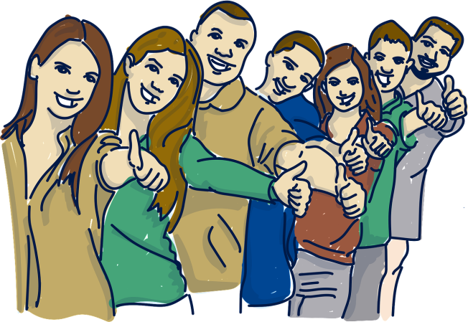
Teacher! What should you do? (5)
Build in a student awareness of rules and principles obligatory in social life. Set rules clearly and be consistent in enforcing them. Tell a student about expectations of him (e.g. “I expect you will not interrupt when someone is speaking”, “I want you to wait patiently until I will approach you”).
Make a student aware of a fact that he is a part of a community where every person is necessary and every person has his own tasks.
A picture from pixabay.com

Slide 68
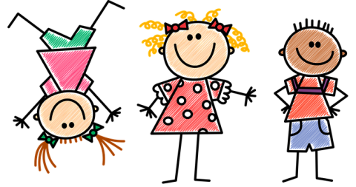
Teacher! What should you do? (6)
Develope altruism and seeing other people’s needs in a student (encourage him to get involved in a voluntary service, ask a student to help other students).
Involve parents in working on correct self-esteem in their child
Emphasize how important it is to show their interest in their child not only when he tries to force it.
Ask parents not to replace their child in doing tasks but to encourage a child to be self-reliant.
Propose that parents encourage a child to build relations with other children where he could learn cooperation.
A picture from pixabay.com

