Slide 1
Scenario 1 – Ball Incident Conflict Theory
ERASMUS + 2019-1-PL01- KA201-06486
Problems in peer relationships

Slide 2
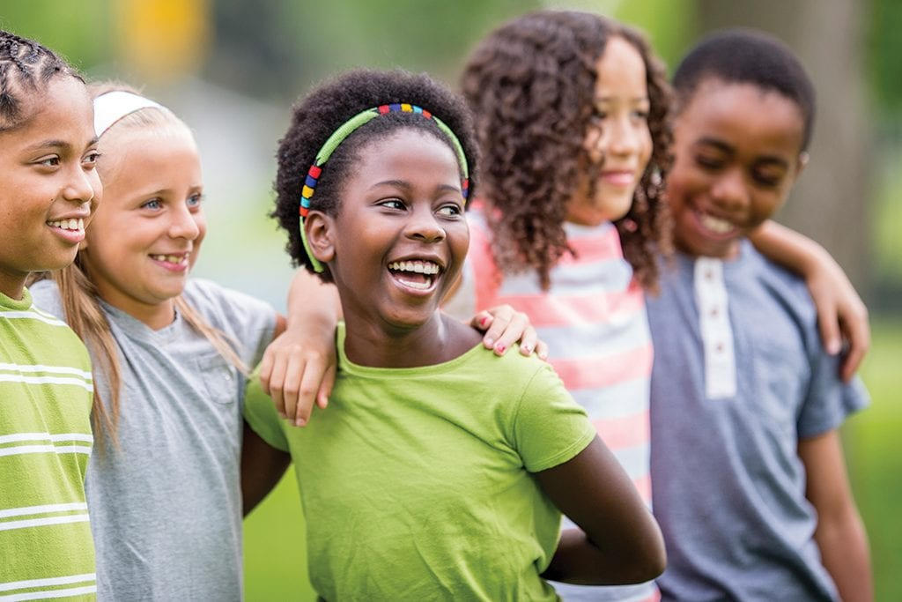
PEER RELATIONSHIPS – THE IMPORTANCE
Children’s interactions with their peers serve several critical developmental functions. A child’s interactions with peers tend to be more egalitarian and free from constraint than their interactions with adults, providing opportunity to develop new skills for fair play and to explore the limits of social tolerance (Hetherington, Parke, & Locke, 1999).
Peers serve as a source of information about social rules, a source of salient reinforcement, and as models for a variety of critical social behaviors (Bukowski, 2003).
Peers provide a standard against which children can compare themselves socially, playing a critical role in the children’s developing self-image (Hetherington et al.).

Slide 3
PEER RELATIONSHIPS - THE IMPORTANCE
Peers play a role in social development and learning related to empathy, caring, social responsibility, negotiation, persuasion, cooperation, compromise, emotional control, conflict resolution, and more.
Peers also provide social and emotional support and are socialization agents who model and mold others’ behaviors and beliefs and solidify their own. The impact of peers begins with early learning.
Peer relationships at school can facilitate or be a barrier to learning and teaching. Peer relationships can also function as helping interventions. Schools play both a passive and active role.

Slide 4
PEER RELATIONSHIPS - RECOMMENDATIONS
Teachers must address both children’s academic and social needs to maintain a supportive and optimal learning. In order to successfully create and maintain an optimal learning environment teacher’s influence on children’s peer relations in the classroom must be intentional.
Teachers should shape children’s social lives through group work, identification members for group projects, classroom culture and seating arrangements.
Teachers should recognize children’s friendships and must be accurate in identifying individual children’s acceptance or rejection by their classmates.

Slide 5
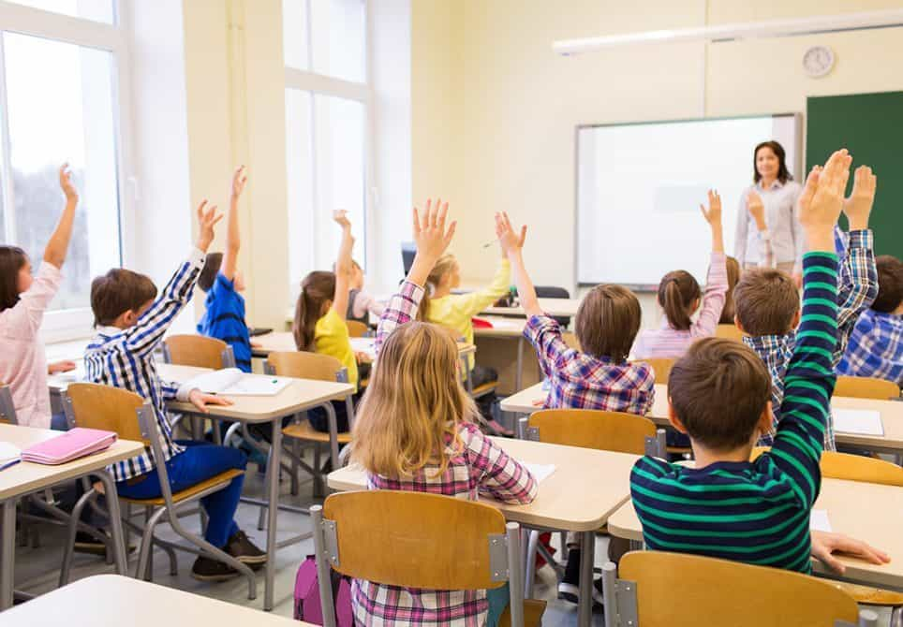
PEER RELATIONSHIPS - RECOMMENDATIONS
Classroom management strategies often focus on reducing negative behaviors, such as disruption or aggression. However, by only focusing on unwanted behaviors, teachers may unintentionally reinforce a child’s negative peer reputation. Teachers should also reward a child’s positive peer interactions, which highlight positive attributes, to provide counter evidence against a child’s negative peer reputation.
A simple way of giving positive reinforcement in behavior modification is in providing compliments, approval, encouragement, and affirmation; literature says that a ratio of five compliments for every one complaint is generally seen as being the most effective in altering behavior in a desired manner.

Slide 6
STRATEGIES FOR PROMOTING PEER RELATIONSHIPS EXAMPLES OF MICRO-CHANGES IN ROUTINES AND PRACTICES
PEER FRIENDSHIPS
• Find multiple tasks for students to complete with a classmate and, occasionally, assign them to unexpected partners. These can be classroom chores, instructional tasks, or classroom privileges.
• Teach students to play non-competitive games that are appealing but have no clear winners and losers.
• Add many more attractive and developmentally appealing games to the playground with special attention to games that can be played by students with limited athletic ability, games for small and large groups, and games that are very physical or very sedate.
• Hold ‘game clinics’ in which a new game is taught at recess – start with a small group that includes a few isolated students. Once the game starts, anyone can join.

Slide 7
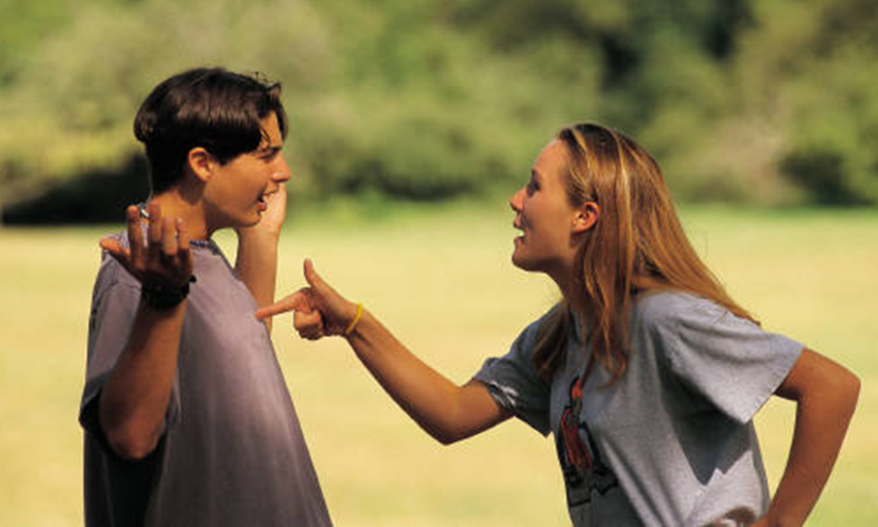
STRATEGIES FOR PROMOTING PEER RELATIONSHIPS EXAMPLES OF MICRO-CHANGES IN ROUTINES AND PRACTICES
PEER CONFLICT
• Solve frequent and predictable arguments in advance with classroom meetings.
• Have students who argue complete a ‘conflict worksheet’ together to talk through what happened and how to fix it
• Relocate playground games so that they don’t bump into each other.
• Write simple school rules for the common playground games (soccer, basketball, four square) that students often argue about.
• Make a routine for choosing teams once a week (balancing the skills on teams) and use those same teams until the next week
• Add more supervisors to the playground or change where they are located.
• Change what supervisors do: have them actively circulate on the playground and prompt students to play and resolve conflicts
• Conduct a ‘recess workshop’ in which all students who tour the playground together while reviewing the routines, rules, proper use of equipment, entry/exit procedures, strategies for having fun together, and supervisors’ actions when there are problems. Add a booster workshop midway through the year.
• Invite a prominent local athlete to the school to talk about good sportsmanship.

Slide 8
STRATEGIES FOR PROMOTING PEER RELATIONSHIPS EXAMPLES OF MICRO-CHANGES IN ROUTINES AND PRACTICES
AGGRESSIVE CONFLICT AND BULLYING
• Have students mark playground maps with the places where bullying occurs and plan extra supervision of these places.
• Encourage students who are the targets of bullying to play near supervisors.
• Conduct classroom meetings to increase empathy in the students who observe bullying and prepare them to stop it.
• Meet with all playground supervisors to discuss aggressive conflict and ways to interrupt it.
• Sensitize students to bullying by using a video or a book to prompt a class discussion of what it feels like to be bullied.

Slide 9
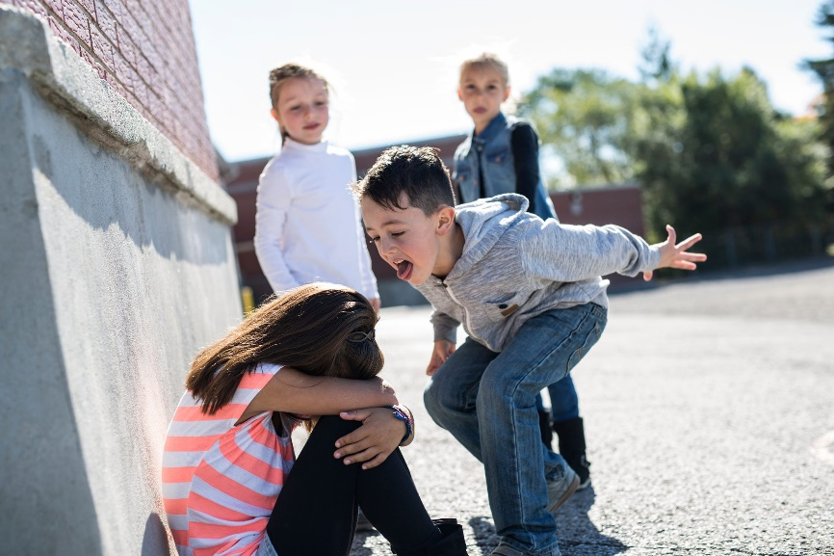
POSSIBLE CAUSES FOR DIFFICULTIES IN PEER RELATIONSHIPS
Impulsivity
Aggressivity
Communication Disorders
Bullying
Anti-Social Behaviors/Rule Breaking Behaviors
Internalisation Problems
Cultural and Ideological Differences
Disabilities (PHDA)

Slide 10
IMPULSIVITY - INTRODUCTION
Impulsive behavior of students can be a great problem for any teacher. It distracts the whole class, disrupts lectures, and can be a hindrance to the learning process.
Teachers must be able to understand the nature of impulsivity in children in order to manage classroom situations properly.

Slide 11
IMPULSIVITY - DEFINITION
The conceptualization of impulsiveness is not consensual among the scientific community, but it is commonly accepted that it is a multidimensional construct, being defined as "a predisposition for rapid and unplanned actions to external and internal stimuli, without taking into account the negative consequences for impulsive individuals and/or for others" (Moeller, Barratt, Dougherty, Schmitz, & Swann, 2001; p. 1784).
Impulsivity has been, in the scientific literature, associated with behavioural problems such as: aggressiveness, maladjusted behaviours, difficulties in relationships with peers, externalisation behaviours, future anti-social behaviour or as a fundamental characteristic of ADHD disorder.

Slide 12
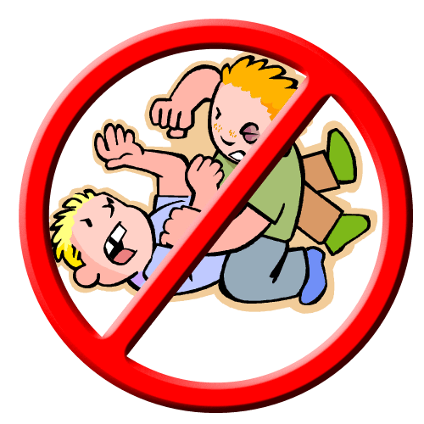
IMPULSIVITY - MANIFESTATIONS
Impulsivity doesn’t appear the same way in every child. And the behaviors can change as kids get older. When kids are impulsive, they might:
Do silly or inappropriate things to get attention
Have trouble following rules consistently
Be aggressive toward other kids (hitting, kicking, or biting is common in young kids)
Have trouble waiting their turn in games and conversation
Grab things from people or push in line
Overreact to frustration, disappointment, mistakes, and criticism
Want to have the last word and the first turn
Not understand how their words or behavior affect other people
Not understand the consequences of their actions
Take more risks with dating and sex, driving, and alcohol or drugs

Slide 13
RECOMMENDATIONS FOR TEACHERS
Help teach the student that persons who take turns and act in a deliberate fashion are more successful than those who act impulsively. Use positive reinforcement based on the length of time the student can be successful at controlling his/her impulsive behavior. As the student demonstrates higher levels of success, gradually increase the length of time required for reinforcement.
When the student demonstrates impulsive behavior, try to use a predetermined signal, such as a hand signal or verbal cue, to remind the student to slow down and think of the consequences that may result from the anticipated impulsive behavior.
Closely monitor behavior and intervene early when a problem presents itself. This should prevent a more serious problem from developing. Close monitoring is especially important in situations that tend to trigger impulsive behavior (e.g., playground, lack of structure, etc.).
When correcting the student, focus on the specific impulsive behavior and not the global self (e.g., communicate “what you did was wrong,” and not “you’re a bad person.”)
Emphasize the impact of impulsive behavior on others.
In order to foster a feeling of success or accomplishment, assign various additional responsibilities to the student.
Provide assistance to the student when beginning a new task, in an attempt to reduce impulsivity. Provide clear explanations and instructions so that the student is made aware of exactly what is expected. Evaluate tasks assigned to the student to determine if they are too difficult and if the length of time to complete each task is appropriate.

Slide 14
RECOMMENDATIONS FOR TEACHERS
Structure activities to help prevent the student from becoming overstimulated. Preview with the student what is expected in an academic or social activity.
Provide the student with decision-making criteria. For example, a) take into consideration how other persons may be affected; b) consider possible consequences; c) take into consideration different courses of action; d) thoroughly assess the specific situation; e) decide what is the best course of action for the individual student. Model these steps yourself in the classroom.
Provide visual reminders of how to avoid impulsive behavior. For example, post an index card on the student’s desk that says STOP THINK ACT.
If needed, develop a contract with the student in which you specify what type of behavior is expected and what the student can expect in the way of reinforcement if the contract is honored.
Highlight peer models of impulsivity control. Seat the student near such models.
Make sure that your concerns are effectively communicated to the parents. This will allow you to share information concerning the student’s progress and will allow the parents to reinforce the student’s positive behaviors at home.

Slide 15
Scenario 1 – Ball Incident Situation Description
ERASMUS + 2019-1-PL01- KA201-06486
Problems in peer relationships

Slide 16
Ball Incident
Peter has a soccer ball he brought from home to school.
The three friends decide to play football, as Peter offers his ball to play at that break.
After 10 minutes of playing, John is very upset because he is not scoring goals.
John starts calling names to his friends and being aggressive in the game for them.
When John recovers the ball, he trips Peter in which Peter falls and gets hurt on his knee.
John managed to score a goal after he hurt Peter.
When John realizes that he hurt his friend, he meets him in the field and tries to apologize.
However, Peter does not want to hear John or Sarah and leaves the football field, taking the football with him.
When he takes the ball he says that his friends cannot play anymore because the ball is his.

Slide 17
Scenario 2 – Bullying Incident Conflict Theory
ERASMUS + 2019-1-PL01- KA201-06486
Problems in peer relationships

Slide 18
PEER RELATIONSHIPS - THE IMPORTANCE
The manner in which one interacts and forms relationships with others through early childhood, middle childhood, and adolescence is a cornerstone of most major developmental theories (e.g., Erikson, 1968; Parker, Rubin, Erath, Wojslawowicz, & Buskirk, 2006). The formation of social skills that permit effective negotiation of peer-related interactions and interpersonal relationships is arguably one of the most important developmental tasks. As such, peer relationships make a strong contribution to many aspects of normal and abnormal development (Bukowski & Adams, 2005).

Slide 19
PEER RELATIONSHIPS - RECOMMENDATIONS
Teachers must address both children’s academic and social needs to maintain a supportive and optimal learning. In order to successfully create and maintain an optimal learning environment teacher’s influence on children’s peer relations in the classroom must be intencional.
Teachers should shape children’s social lives through group work, identification members for group projects, classroom culture and seating arrangements.
Teachers should shape children’s social lives through group work, identification members for group projects, classroom culture and seating arrangements.
Teachers should recognize children’s friendships and must be accurate in identifying individual children’s acceptance or rejection by their classmates.

Slide 20
STRATEGIES FOR PROMOTING PEER RELATIONSHIPS EXAMPLES OF MICRO-CHANGES IN ROUTINES AND PRACTICES
PEER FRIENDSHIPS
• Find multiple tasks for students to complete with a classmate and, occasionally, assign them to unexpected partners. These can be classroom chores, instructional tasks, or classroom privileges.
• Teach students to play non-competitive games that are appealing but have no clear winners and losers.
• Add many more attractive and developmentally appealing games to the playground with special attention to games that can be played by students with limited athletic ability, games for small and large groups, and games that are very physical or very sedate.
• Hold ‘game clinics’ in which a new game is taught at recess – start with a small group that includes a few isolated students. Once the game starts, anyone can join.

Slide 21
STRATEGIES FOR PROMOTING PEER RELATIONSHIPS EXAMPLES OF MICRO-CHANGES IN ROUTINES AND PRACTICES
PEER CONFLICT
• Solve frequent and predictable arguments in advance with classroom meetings.
• Have students who argue complete a ‘conflict worksheet’ together to talk through what happened and how to fix it
• Relocate playground games so that they don’t bump into each other.
• Write simple school rules for the common playground games (soccer, basketball, four square) that students often argue about.
• Make a routine for choosing teams once a week (balancing the skills on teams) and use those same teams until the next week
• Add more supervisors to the playground or change where they are located.
• Change what supervisors do: have them actively circulate on the playground and prompt students to play and resolve conflicts
• Conduct a ‘recess workshop’ in which all students who tour the playground together while reviewing the routines, rules, proper use of equipment, entry/exit procedures, strategies for having fun together, and supervisors’ actions when there are problems. Add a booster workshop midway through the year.
• Invite a prominent local athlete to the school to talk about good sportsmanship.

Slide 22
POSSIBLE CAUSES FOR DIFFICULTIES IN PEER RELATIONSHIPS
Impulsivity
Aggressivity
Communication Disorders
Bullying
Anti-Social Behaviors/Rule Breaking Behaviors
Internalisation Problems
Cultural and Ideological Differences
Disabilities (PHDA)

Slide 23
BULLYING DEFINITION
Bullying comprises all aggressive, intentional and repeated attitudes, which occur without obvious reason, causing pain and distress, executed within an unequal power relationship.
We define bullying as what the literature refers to as aggressive behaviors that present a set of common characteristics, among which various strategies of bullying the other are identified, and which result in violent practices exercised by an individual or small groups on a regular and frequent basis. The concept of bullying contains both individual and group aggression (Olweus, 1993).

Slide 24
BULLYING CHARACTERISTICS
According to some authors, bullying is characterized by the following criteria:
the intentionality of the behavior, i.e., the main objective is to cause distress and gain control over the individual;
the procedure is produced repeatedly over time, i.e., it does not happen occasionally, but is chronic and regular;
and, finally, there is an imbalance of power in the practice of bullying, since offenders see their victims as an easy target. An argument or struggle between two students of the same age, size, strength and power, in most cases, is not bullying. Bullying is not a sporadic episode. On the contrary, it can last for weeks, months, and even years. The student or group of aggressor students treats their colleague cruelly, persecutes, oppresses and torments them, making them their usual victims.

Slide 25
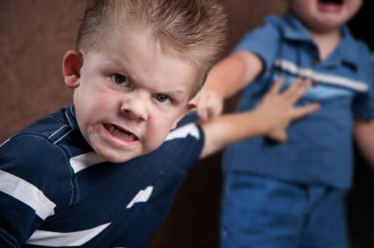
TYPES OF BULLYING
Bullying can take many forms and include different behaviors, such as: violence and physical attacks; verbal offenses, nicknames and insults; threats and intimidation; extortion and theft of money and belongings; exclusion from the peer group, among others.
a) Examples of physical violence include punches, pushing, kicking, elbowing, assault with objects, spitting, among others. This type of violence includes surrounding the victim, locking her in a room, waiting for her outside the school and mistreating her to take her belongings. This type of bullying manifests itself more in primary education, being a type of direct behavior.
b) Verbal violence is the most common type and, in recent times, new technologies, such as mobile phones, have become a means of achieving it. It consists of insults, bad language, public contempt, highlighting physical defects, etc. It is also a direct type of behaviour and the quickest way for the aggressor to test his ability to destabilise the victim and control them.

Slide 26
TYPES OF BULLYING
c) Psychological violence is found in all forms of maltreatment and psychological maltreatment usually ends in physical maltreatment. Actions are created with the intention of deteriorating the individual's self-esteem and fostering their sense of insecurity and fear. In this context, the aggressor manipulates the victim emotionally, pretending to be their friend, blackmailing them, taking advantage of their weaknesses, telling them that if they does not do so they will tell them something that has been confided to them. This psychological bullying makes the victim always emotionally dependent on the aggressor, destroying their self-esteem and fostering their sense of fear. Psychological violence is generally more frequent among girls than boys. In many cases, it is used to force the victim to do the abuser's work, demand gifts from them, extort money from them, or make them feel guilty when the abuser needs it. It's a kind of indirect behavior.
d) Social violence wishes to drive the victim away from the rest of the group and from colleagues. It is usually done through commentary, verbal abuse, insults, threats, aggression, ignoring the victim and following them home from school, treating them as slaves, etc. It can be racial, religious or even sexist violence. For example, in games or male activities, girls are removed when it comes to participating. It is also indirect behaviour.

Slide 27
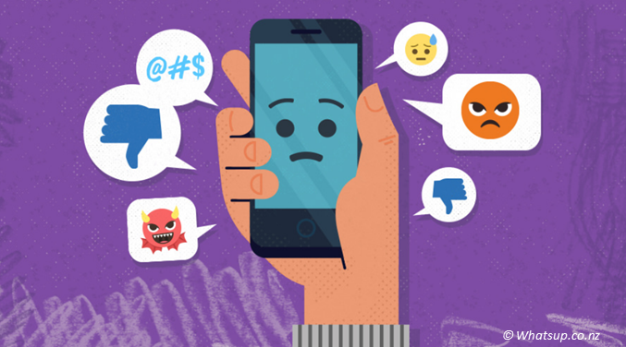
TYPES OF BULLYING
e) Sexual bullying includes physical contact with girls or boys without their consent, obscene gestures, requests for sexual favors, excessive relationships with a partner if the partner does not want them to, demonstrations of sexual intention or sexual messages implying that the victim acted with the intention of seducing and disrespecting them. It is a type of behaviour that can be direct or indirect, manifestly abuse of power.
f) Cyberbullying has been defined as any behavior performed through electronic or digital media by individuals or groups that repeatedly communicates hostile or aggressive messages intended to inflict harm or discomfort on others. Recent studies show that it occurs via mobile phones (text messages, phone calls) or via the Internet (emails, photos or video clips). Cyberbullying seems to be an anonymous and individualistic activity, the most common being joking, insulting.

Slide 28
CAUSES OF BULLYING
According to some researchers, identifying the causes of bullying is a complex job. There is no list of causes that can be applied in an investigation, because each case is unique and its causes will be specific. Furthermore, it would be wrong to attribute only one cause to a bullying situation because several factors may have had an influence on the case.
Psychological factors seem to be relevant. Victims and perpetrators show low self-esteem and a bad influence on interpersonal relationships with peers. Victims usually have no friends, have a fragile physical appearance in relation to their peers, and are usually highly protected by their parents. In general, the parents of the aggressors and victims are not aware of the situation, making it even more ambiguous.
School violence associated with organised groups or gangs seems to be associated with economic, social and ethnic factors, such as broken families, racism, poverty and other types of systematic discrimination.

Slide 29
EFFECTS OF BULLYING
Like the causes, the consequences of bullying can be varied and depend on the case in question. Usually, the victim's fear of talking leads her to develop problems such as depression and low self-esteem. These effects are not always visible, not least because they do not manifest themselves physically. In other cases, the victim herself tries to hide their effects out of fear, covering up even the most visible ones, such as injuries.
In general, this negative action, intentional and continued, generates negative effects on victims such as: depression, anxiety, low self-esteem, difficulties in interaction in the school environment and difficulties in normal learning development.
Watch: Video 1

Slide 30
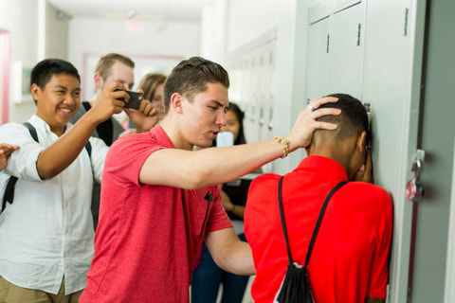
TYPES OF PARTICIPANTS
In a bullying episode there's always a victim and an perpetrator. However, there may be other participants or the victim and/or aggressor may be a group.
Two types of victims can be distinguished: a) the provocative victims, who partly cause the bullying; and b) the classic victims, who are assaulted without having provoked.
And the following participants can be distinguished: a) ringleader bullies, i.e., offenders who take the initiative; b) follower bullies, offenders who join the one who took the initiative; c) reinforcers, i.e., those who encourage the offender or laugh at the victim; d) defenders, who help the victim; e) bystanders, who stay out of or move away from the situation; f) and, finally, victims themselves.

Slide 31
CHARACTERISTICS OF PERPETRATORS/VICTIMS/ OBSERVERS
Perpetrators
Inappropriate perception of hostile intentions in the actions of others
They were often exposed to models with aggressive behaviors
Chronically repeat aggressive behavior
They control others with physical and verbal threats
Bad and vindictive
Bad models (parents) of social rules and problem solving
They have more family problems
Lack of parental supervision
They like to contact aggressive groups more
Inconsistent discipline at home
They see aggression as a means of preserving their self-image
Focused on bad thoughts
They perceive their physical image as important to their senses of power and control
More likely to suffer physical and emotional abuse at home
Display obsessive or rigid actions
Frustrated with peers and creating resentment

Slide 32
CHARACTERISTICS OF PERPETRATORS/VICTIMS/ OBSERVERS
Victims
Inefficient social skills
Less popular
Poor interpersonal skills
Limited skills to gain acceptance and success
They believe they can't control the environment
Limited communication skills in stressful situations
They have overlapping fears of personal inadequacy
Physical mannerisms associated with depression.
Socially isolated
Frequent feelings of personal inadequacy
Fear of going to school
Performs self-destructive actions
Physically younger, smaller and weaker than their peers
Do you believe others are more capable
Weak concept of our own
Feels that external factors have a greater impact than internal control
Difficulty in relating to peers
Has under-involved families in its decisions and activities
Personal shame about your problems
The perception of progressive failures causes the targets to successively make less effort in the following situations

Slide 33
CHARACTERISTICS OF PERPETRATORS/VICTIMS OBSERVERS
Witnesses, observers or non-participants
Although not directly involved in the violent acts, become witnesses and learn to live with the episodes of bullying by remaining silent and showing negative feelings towards what they observe.
These students, being observers, suffer from fear, doubt about how to act, and disbelief in the ability and interest of the school to solve the problem. School performance may drop, as adolescents' attention is directed towards the aggressive attitudes practiced and suffered by their peers. Witnessing bullying is a major risk factor for dissatisfaction with school, as it can compromise academic and social development.

Slide 34
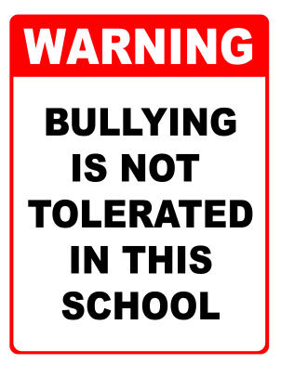
BULLYING PREVENTION: RECOMMENDATIONS FOR SCHOOLS
The role of schools in preventing bullying.
The school should be a safe and positive learning environment for ALL students. In order to achieve this goal, schools should strive to:
Reduce, if not eliminate, existing bully/victim problems among students in and outside of the school setting;
Prevent the development of new bully/victim problems; and
Achieve better peer relations at school and create conditions that allow in particular, victims and bullies to get along and function better in and outside of the school setting.

Slide 35
BULLYING PREVENTION: RECOMMENDATIONS FOR SCHOOLS
Recommended general rules for improving overall school climate.
Two general conditions must exist in order to prevent bullying: (1) adults at schools should be aware of the extent of bully/victim problems in their own schools; and (2) these adults should involve themselves in changing the situation.
Schools and classrooms should establish and stick to rules to prevent bullying. Adults must clearly and consistently communicate that bullying is not acceptable behavior. The following rules target all students:
We will not bully other students.
We will try to help students who are bullied.
We will make it a point to include ALL students who are easily left out.
When we know somebody is being bullied, we will tell a teacher, parent, or adult we trust. Students should be assured that telling an adult is not "tattling," but instead students are showing compassion for victims of bullying behavior.
It is important to note that these rules target all students, not just the bullies or victims. The introduction of these rules establish classroom norms or "structures" that can contribute to the prevention of bullying.

Slide 36
BULLYING PREVENTION: RECOMMENDATIONS FOR SCHOOLS
Consequences of bullying behavior.
Establishing rules against bullying necessitates creating positive or negative consequences for following or violating rules. The best results are obtained through a combination of generous verbal praise or other social reinforcements for positive activities and consistent negative consequences for aggressive, rule-violating behavior. Teachers should establish a positive, friendly, and trusting relationship with the class and each individual student. This is especially true for aggressive, acting-out students who may have had negative experiences with adults. It is easier for a student to accept criticism if he/she feels appreciatedand liked. Teachers should also be aware of their own behavior. Teachers often serve as "models" for students who respect them and may wish to emulate them. Likewise, students will not respect the teacher or classroom rules against bullying if the teacher is sarcastic, unfair, or abusive.

Slide 37
SCHOOL-LEVEL INTERVENTIONS
School-level interventions are designed to improve overall school climate. These interventions target the entire school population.
Establish a Bullying Prevention Coordinating Committee: This committee will coordinate all aspects of a school’s violence prevention efforts, including anti-bullying efforts.
Administer an Anonymous Questionnaire Survey : A student questionnaire can determine the nature and extent of bully/victim problems in the school.
Hold a School Conference Day : Raise school and community awareness and involvement by creating a longterm anti-bullying plan. In addition to school personnel, selected students and parents should participate.
Improve Supervision and Outdoor Environment: Provide adequate number of adults ("teacher density") during lunch, recess, and breaks in an effort to intervene quickly in student conflicts.
Involve Parents: Conduct meetings with and disseminate information to parents at the school to make them aware of the school’s anti-bullying plan of action.

Slide 38
CLASSROOM-LEVEL INTERVENTIONS
Classroom-level interventions are designed to improve an individual classroom’s social climate. These interventions target the entire classroom.
Establish Classroom Rules Against Bullying: Involve students in creating rules against bullying in order to develop a student’s personal responsibility for conforming to those rules.
Create Positive and Negative Consequences of Bullying: Establish social reinforcement (i.e., praise, friendly attention) for positive behavior and sanctions for undesirable behavior. The negative consequence should cause discomfort without being perceived as malicious or unfair. Negative consequences should be appropriate and related to the behavior. Extra assignments, such as homework or copying from a dictionary, should not be used.
Hold Regular Classroom Meetings : Provide a forum for students and teachers to develop, clarify, and evaluate rules for anti-bullying behavior.
Meet with Parents: Hold general classroom - or grade-level meetings with parents to improve school-family communication and keep parents informed about anti-bullying efforts.

Slide 39
INDIVIDUAL-LEVEL INTERVENTIONS
Individual-level interventions are designed to change or improve the behavior of students in general. These interventions target specific students who are involved in bullying, either as bullies or victims.
Serious Talks with the Bully or Bullies: Initiate immediate talks with the bully/ies. These talks should include:
· documenting involvement of participation in bullying,
· sending a clear, strong message that bullying is not acceptable,
· warning the bully/ies that future behavior will be closely monitored, and· warning that additional negative consequences will be administered if bullying behavior does not stop.
Serious Talks with the Victim: Talks with the victim and his/her parents should occur after a bullying incident. These talks should include:
· documenting specific bullying episode(s) that includes: How did the bullying start? What happened? How did it end? Who participated and in what way?;
· providing victim with information about the teacher ’s plan of action in dealing with the bully/ies; and
· attempting to persuade the victim to immediately report any new bullying episodes or attempts to the teacher.

Slide 40
INDIVIDUAL-LEVEL INTERVENTIONS
Involve the Parents: When a bullying situation is discovered, the teacher should contact the parents concerned. Depending on the situation, meetings can be held together with the parents of both the bully/ies and the victim, or to minimize tension meetings can be held with each family separately. A teacher might want to invite the school psychologist, guidance counselor, principal, or vice principal to attend.
Change of Class or School: If anti-bullying measures are in place and the problem persists despite these measures, moving the aggressive student(s) can bring about change. If possible, the aggressive student(s) should be moved before considering moving the victim. This solution should not be taken lightly, and all concerned parents and teachers should plan and consult with each other.
WATCH: Video 2

Slide 41
Scenario 2 – Bullying Incident Situation Description
ERASMUS + 2019-1-PL01- KA201-06486
Problems in peer relationships

Slide 42
BULLYING INCIDENT
The students had left class and gone outside.
Mary was cradled in a corner of the playground by the benches at the end of the football field and next to her were Laura and Brian.
Laura was shaking her arms pointing at Mary. She called her ugly names.
Brian was standing right next to them but didn’t do anything.
Mary was the best student in their class.
In her previous class, Mary outranked Laura in every assignment given by their teacher and she was extremely angry with Mary. Because she thought that she challenged her.
Laura was not a good student and had behavior problems, she missed class and was often suspended for bad behavior in class and outside of it.
Because she was angry with Mary because of what happened in class, she chased her to the playground, pushed her to the floor and offended her by making fun of her.
Meanwhile, beside her was Brian just watching the whole situation, while Laura mocked Mary.
This situation has been repeated since the beginning of the school year.

Slide 43
Scenario 2 – Bullying Incident Concluding Notes
ERASMUS + 2019-1-PL01- KA201-06486
Problems in peer relationships

Slide 44
BULLYING
KEEP IN MIND...
As an educator, you have a responsibility to create a safe and healthy environment in your classroom—one that protects every student from bullying. This means you must not only identify and address bullying on a consistent basis, but you also must create a culture of respect and dignity in your classroom.
From physical altercations to rumors and gossip, bullying can have lasting effects on an educational environment. As a result, preventing school bullying is extremely important for educators.
Lets resume the best ways to do it!!!

Slide 45
BULLYING
KEEP IN MIND...
Talk About Bullying
Be Visible Throughout the Day
Become Familiar With Bullying Indicators
Teach Students to be Effective Bystanders
Rely on other students to let you know when bullying is occurring
Maintain Open Communication With Students
Increase Bullying Awareness Among Parents
Prevent Cliques in Your Classroom
Be an Advocate for Anti-Bullying
Create a Sense of Community
Respond Quickly to Every Bullying Incident
Speak With the Victim Privately
Speak With the Bully Separately
Develop Appropriate Interventions
Keep a Close Eye on the Situation
Check in With Both the Victim and the Bully
Establish Your Classroom as a Safe Place

Slide 46
Scenario 3 – Stealing Incident Conflict Theory
ERASMUS + 2019-1-PL01- KA201-06486
Problems in peer relationships

Slide 47
PEER RELATIONSHIPS - THE IMPORTANCE
The manner in which one interacts and forms relationships with others through early childhood, middle childhood, and adolescence is a cornerstone of most major developmental theories (e.g., Erikson, 1968; Parker, Rubin, Erath, Wojslawowicz, & Buskirk, 2006). The formation of social skills that permit effective negotiation of peer-related interactions and interpersonal relationships is arguably one of the most important developmental tasks. As such, peer relationships make a strong contribution to many aspects of normal and abnormal development (Bukowski & Adams, 2005).

Slide 48
PEER RELATIONSHIPS - RECOMMENDATIONS
Classrooms are social settings that influence the context of social interactions. Most teachers are cognizant of the classroom culture they want to cultivate; they seek to create positive classroom climates that promote individual prosocial behaviors and academic achievement.
Teachers should focus on becoming more attuned to peers dynamics rather than simply recognizing peer affiliations. Attunement constitutes thinking about the classroom peer relations from the perspective of the other students in the classroom. This will allow teachers to intentionally create student work pairs that promote positive peer interactions while minimizing unexpected conflict.

Slide 49
STRATEGIES FOR PROMOTING PEER RELATIONSHIPS EXAMPLES OF MICRO-CHANGES IN ROUTINES AND PRACTICES
PEER FRIENDSHIPS
• Find multiple tasks for students to complete with a classmate and, occasionally, assign them to unexpected partners. These can be classroom chores, instructional tasks, or classroom privileges.
• Teach students to play non-competitive games that are appealing but have no clear winners and losers.
• Add many more attractive and developmentally appealing games to the playground with special attention to games that can be played by students with limited athletic ability, games for small and large groups, and games that are very physical or very sedate.
• Hold ‘game clinics’ in which a new game is taught at recess – start with a small group that includes a few isolated students. Once the game starts, anyone can join.

Slide 50
STRATEGIES FOR PROMOTING PEER RELATIONSHIPS EXAMPLES OF MICRO-CHANGES IN ROUTINES AND PRACTICES
PEER CONFLICT
• Solve frequent and predictable arguments in advance with classroom meetings.
• Have students who argue complete a ‘conflict worksheet’ together to talk through what happened and how to fix it
• Relocate playground games so that they don’t bump into each other.
• Write simple school rules for the common playground games (soccer, basketball, four square) that students often argue about.
• Make a routine for choosing teams once a week (balancing the skills on teams) and use those same teams until the next week
• Add more supervisors to the playground or change where they are located.
• Change what supervisors do: have them actively circulate on the playground and prompt students to play and resolve conflicts
• Conduct a ‘recess workshop’ in which all students who tour the playground together while reviewing the routines, rules, proper use of equipment, entry/exit procedures, strategies for having fun together, and supervisors’ actions when there are problems. Add a booster workshop midway through the year.
• Invite a prominent local athlete to the school to talk about good sportsmanship.

Slide 51
STRATEGIES FOR PROMOTING PEER RELATIONSHIPS EXAMPLES OF MICRO-CHANGES IN ROUTINES AND PRACTICES
AGGRESSIVE CONFLICT AND BULLYING
• Have students mark playground maps with the places where bullying occurs and plan extra supervision of these places.
• Encourage students who are the targets of bullying to play near supervisors.
• Conduct classroom meetings to increase empathy in the students who observe bullying and prepare them to stop it.
• Meet with all playground supervisors to discuss aggressive conflict and ways to interrupt it.
• Sensitize students to bullying by using a video or a book to prompt a class discussion of what it feels like to be bullied.

Slide 52
POSSIBLE CAUSES FOR DIFFICULTIES IN PEER RELATIONSHIPS
Impulsivity
Aggressivity
Communication Disorders
Bullying
Anti-Social Behaviors/Rule Breaking Behaviors
Internalisation Problems
Cultural and Ideological Differences
Disabilities (PHDA)

Slide 53
ANTI-SOCIAL BEHAVIOR DEFINITION
Antisocial behavior has been defined as kind of behavior that is directed against other people, their property or breaks social rules. This type of behavior takes various forms (with different seriousness) such as lying, risky sexual practices, rule-breaking, illegal substance use and disruptive behavior such as theft, destruction, fraud, engaging in aggression (either physical or verbal), and vandalism.This range of behavior makes it a problem whose severity and frequency are a matter of concern.
From the few studies that exist and that address this subject, it is recognized that this type of behavior is very infrequent in childhood, but increase drastically in the course of adolescence and only decay again at the entrance to adulthood.
It is usually maintained during adolescence and adulthood in individuals who displayed behavioral problems in childhood.

Slide 54
ANTI-SOCIAL BEHAVIOR DEFINITION
Antisocial behaviors can be divided into two categories: overt antisocial behaviors and covert antisocial behaviors. An example of an overt antisocial behavior in school you might see is fighting, while an example of a covert antisocial behavior is a theft in which the student does not confront the victim, such as taking something out of a desk or backpack when the other child is not there. Children with antisocial behavior may have relationship problems with their teachers and classmates and may also suffer from depression.
Antisocial behavior is one of the most common forms of psychopathology among children and youth and is the most frequently cited reason for referral to mental health services.

Slide 55
ANTI-SOCIAL BEHAVIOR RISK FACTORS
The forms of social interaction that "teach" children antisocial behaviors are numerous - adult modeling, television, association with antisocial peer groups, dysfunctional parent-child interactions, coercive school environments.
The influence of a number of risk factors linked to the development of this type of behavior has been found, including family environment and involvement with antisocial peers.
As for the family environment, risk factors associated with the development of antisocial behavior include marital conflict, family stress, parental authoritarianism, parental criminality, domestic violence, social marginalization and coercive social interaction between parents and children.

Slide 56
ANTI-SOCIAL BEHAVIOR RISK FACTORS
There are multiple determinants of anti-social behavior as we could see. However, the school appears to be a major contributor, and factors similar to those identified in the school have been identified in the home: a coercive and punitive environment and inconsistencies in rule setting and applying consequences. Other factors include low involvement and integration in school and a lack of appropriate parenting skills, antisocial networks,and too little for youngsters to do. Three major factors within schools were identified that appear to promote a context in which punishment and extinction conditions are likely to occur: a lack of clarity of both rules and policies; weak or inconsistent staff support and administrative follow-through; and few or no allowances made for individual differences. The resultant specific occurrences of punishment and extinction (e.g., disapproving comments, academic task errors, and a lack of recognition for either student or staff effort) appear to serve as setting events that evoke aggression, attendance problems (escape), and other anti-social behaviors. It appears, then, that a punitive school discipline environment is a major factor contributing to antisocial behavior problems.

Slide 57
ANTI-SOCIAL BEHAVIOR INTERVENTION
Intervention should focuses on four overlapping and interrelated systems:
school-wide,
non-classroom,
classroom, and
individual student.
The purpose of establishing a school-wide system is to address the behavioral needs of the majority of students in a school across settings. These students are likely to have learning histories for which correcting problem behaviors and explicitly teaching rules and procedures for prosocial behaviors will be effective. The non-classroom system focuses on providing behavioral support in non-instructional areas (e.g. cafeteria, playgrounds, hallways) where problem behaviors frequently occur. Classroom systems should incorporate instruction of behavior expectations and routines, as well as continuums of procedures for encouraging expected behaviors and discouraging rule violations. The individual student system for positive behavioral support focuses on the very small portion of students who require individualized interventions and supports.

Slide 58
ANTI-SOCIAL BEHAVIOR INTERVENTION
In general, most schools have a disciplinar handbook that delineates the policies and procedures for maintaining a safe school where learning and teaching can occur. Unfortunately, the emphasis is frequently focused on delineating what behaviors represent district and state rule violations and the associated graduated sanctions that accompany each violation. Little information is provided about the expectations for acceptable behavior and the strategies that students, teachers, and parents might employ to encourage these expectations. All students, but especially students with antisocial behavior, must be exposed to clearly specified and consistently implemented discipline systems that both encourage prosocial behaviors and discourage rule violations.

Slide 59
ANTI-SOCIAL BEHAVIOR INTERVENTION
Six main strategy components comprise comprehensive proactive schoolwide behavioral support systems:
First is a simple, clear, and positive purpose statement that serves as the foundation for the learning and teaching process in a school.
The second component is a set of proactive expectations or rules that serve as the basis for creating and maintaining safe and productive learning and teaching environments. These expectations are always positively stated and small in number.
The third component consists of a set of strategies for teaching the schoolwide expectations. Although most students have learning histories that include mastery and use of typical schoolwide expectations, teaching these expectations to all students ensures that students and staff have been exposed to a common language and meaning for each expectation. Teaching the expectations schoolwide also stresses the importance of these rules to the functioning of the school, and focuses on building a positive schoolwide climate. Expectations are taught using positive and negative examples, across multiple contexts, and with many opportunities to practice the skills.

Slide 60
ANTI-SOCIAL BEHAVIOR INTERVENTION
A planned continuum for encouraging the proactive schoolwide expectations is the fourth component. After all students and staff have been exposed to and practiced the schoolwide expectations, students must have regular and frequent opportunities to receive contingent positive feedback when they display behaviors that represent a given schoolwide expectation.
The fifth component is a continuum of strategies for responding to rule infractions. This componente usually is specified in great detail in most schools. Sanctions for minor offenses (e.g., tardiness, talking out) are typically handled by individual teachers, whereas major offenses (e.g., fighting, defiance, property destruction, weapons) involve the school council and the student's parents. Clear definitions of what is to be handled by teachers and what is to be sent to the school council must be provided, and consistent implementation of consequences must occur.
The last component of a proactive schoolwide system is a process for monitoring the implementation of the system and for collecting data to evaluate its effectiveness.

Slide 61
ANTI-SOCIAL BEHAVIOR INTERVENTION
The classroom teacher needs to ensure acceptance for all students in the classroom. Teachers’ actions that can promote acceptance include:
• choosing learning materials to represent all groups of students
• ensuring that all students can participate in extra activities
• valuing, respecting, and talking about differences
• celebrating cultural and ethnic differences
• ensuring that learning activities are designed for a variety of abilities
• ensuring that all students are protected from name-calling or other forms of abusive language
• modelling acceptance

Slide 62
ANTI-SOCIAL BEHAVIOR INTERVENTION
Developing Classroom Rules
Well-defined rules in the classroom can prevent many behavioral difficulties. When students are involved in the development of the rules, they are more likely to adhere to them and understand why they have been put into place.
Teaching Classroom Rules
Creating the rules is only the beginning. Once agreed upon, the rules should be taught to the students and posted in the classroom in both print and visual formats. The rules should be explained using clear, concise language.

Slide 63
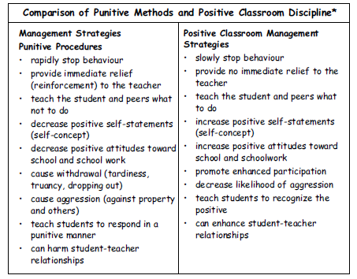
ANTI-SOCIAL BEHAVIOR INTERVENTION
Positive Classroom Discipline
Teachers need to build a classroom environment where positive interactions are the norm and punitive consequences are minimized. Research indicates that coercive or punitive environments actually promote antisocial behaviour.

Slide 64
ANTI-SOCIAL BEHAVIOR INTERVENTION
Teaching Classroom Routines
Classrooms with structured routines and clear procedures are recommended for students with anti-social behavior. Teachers should establish routines for students and set expectations regarding classroom procedures (e.g., getting down to work, arrivals, departures, completing assignments, keeping occupied after work is finished, and transitioning from one assignment or subject area to the next).
Classroom Meetings
Classroom meetings are a useful way to promote a positive classroom atmosphere. They encourage effective communication between the teacher and the students, and provide a good opportunity for the teacher to remind students of individual differences and to involve special students in all classroom activities. The meetings should be held on a regular basis. The teacher and students should work together to establish ground rules for the meetings.

Slide 65
ANTI-SOCIAL BEHAVIOR INTERVENTION
Home-School Communication
Maintaining close contact between the school and the home can prevent misunderstandings. One of the ways is to use a “communication book” to review the day’s events and share information. The book should be designed carefully to ensure that it is easy to use and understand.

Slide 66
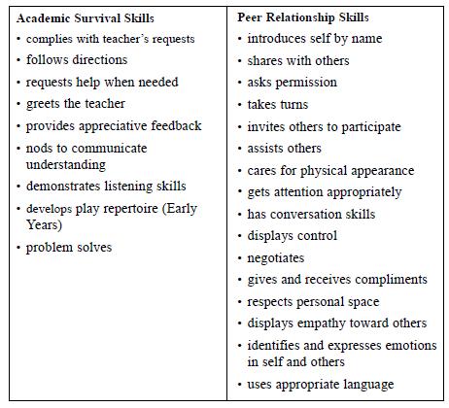
ANTI-SOCIAL BEHAVIOR INTERVENTION
Teaching Social Skills
The goal of social skills instruction is to teach socially acceptable behaviors that will help students be accepted by their classroom peers and teachers, and provide life-long skills.

Slide 67
ANTI-SOCIAL BEHAVIOR INTERVENTION
Teaching Social Stories
Social stories are used to help students with disabilities develop social skills. Social stories can be used to teach new social skills, routines, behaviors, and transitions. Social stories present appropriate social behaviors in the form of a story. The stories are designed to include the answers to questions about acting appropriately in social situations (usually who, what, when, where, and why). Some social stories include visuals to help students understand the social situations.

Slide 68
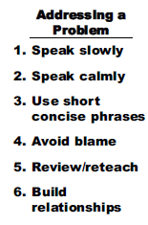
ANTI-SOCIAL BEHAVIOR INTERVENTION
Resolving Behavioural Incidents
Teachers and administrators are often called upon to resolve behavioral incidents involving students with anti-social behaviors. The following suggestions may be useful to reduce the escalation of behavioral incidents.
Review the incident as soon as possible. Try to deal with the incident as quickly as possible once the student has calmed down.
Actively listen. Take time for the student to tell you his or her side of the story. Paraphrase and use eye contact to demonstrate that you are listening. Note that this students may shut down when confronted by an authority figure. Sometimes, a walk around the school with the student can help him or her to relax and begin talking. The teacher or administrator may encourage the student to draw his or her story.
Use non-threatening questions. Ask questions that focus on “how” and “what” instead of “why.” This students may have acted impulsively. Open-ended questions may be most useful. Questions should be asked in a calm, quiet tone using slow, short, concise phrases. A simple problem solving procedure using graphics or pictures may be helpful.
Try not to blame. Focus on teaching the right behavior or a replacement behavior. For example, ask “How can we avoid this problem the next time?” or “What behavior would have worked better than hitting?” Consider using roleplay, modeling, and rehearsing to teach a new behavior. Present new ideas in a concrete way, one at a time. Remember that ideas may need to be reinforced and re-taught several times.
Show personal interest in the student. End the review of the incident with a positive comment or a personal question. Follow up with the student and other classroom teachers in order to reinforce the new skill that is desired.

Slide 69
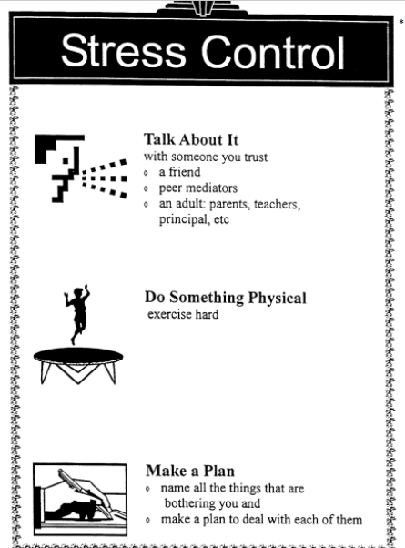
EXAMPLES OF SUPPORT MATERIALS

Slide 70
Scenario 3 – Stealing Incident Situation Description
ERASMUS + 2019-1-PL01- KA201-06486
Problems in peer relationships

Slide 71
STEALING INCIDENT
Robin and Max are 5th year students and are on the benches at the end of the soccer field talking and having a snack.
Meanwhile, Adam, the oldest seventh grader, as always, was wandering the playing field alone.
He passed behind them and stole the wallet he took from Max's backpack.
When it was time for them to go to class, Max noticed that his wallet had been stolen.
Robin said it was Adam because it wasn't the first time he had done something like that.
Adam has been known to skip class, consume illegal substances and graffiti the walls of the school.
He was a lonely and strange boy.
The two classmates were now going to the school board to report on what happened.
There's no doubt that it was Adam who took Max's wallet.

Slide 72
Scenario 3 – Stealing Incident Concluding Notes
ERASMUS + 2019-1-PL01- KA201-06486
Problems in peer relationships

Slide 73
ANTI-SOCIAL BEHAVIORS KEEP IN MIND...
Effective teachers discipline with encouragement and kind words much more often than reprimands. The goal is to help students feel good about themselves and their behavior in the classroom.
What should you do if you have to deal with this problem?
Note: As you can see these tips are for other problems as well.

Slide 74
ANTI-SOCIAL BEHAVIORS KEEP IN MIND...
Take a deep breath and try to remain calm.
Try to set a positive tone and model an appropriate response, even if it means you must take a few moments to compose yourself.
Make sure students understand that it's their misbehavior you dislike, not them.
Give the misbehaving student a chance to respond positively by explaining not only what he or she is doing wrong, but also what he or she can do to correct it.
Never resort to blame or ridicule.
Avoid win-lose conflicts.
Insist that students accept responsibility for their behaviors.
Try to remain courteous in the face of hostility or anger.
Treat all students respectfully and politely.
Be an attentive listener.

Slide 75
ANTI-SOCIAL BEHAVIORS KEEP IN MIND...
Model the behavior you expect from your students.
Specifically describe misbehavior and help students understand the consequences of misbehavior.
Be aware of cultural differences.
Discourage cliques and other antisocial behavior.
Teach students personal and social skills.
Teach students academic survival skills,
Avoid labeling students as "good" or "bad."
Focus on recognizing and rewarding acceptable behavior
Ignore or minimize minor problems instead of disrupting the class.
Where reprimands are necessary, state them quickly and without disrupting the class.
When it's necessary to speak to a student about his or her behavior, try to speak in private.

Slide 76
Scenario 4 – Cultural Differences Incident Conflict Theory
ERASMUS + 2019-1-PL01- KA201-06486
Problems in peer relationships

Slide 77
PEER RELATIONSHIPS - THE IMPORTANCE
The manner in which one interacts and forms relationships with others through early childhood, middle childhood, and adolescence is a cornerstone of most major developmental theories (e.g., Erikson, 1968; Parker, Rubin, Erath, Wojslawowicz, & Buskirk, 2006). The formation of social skills that permit effective negotiation of peer-related interactions and interpersonal relationships is arguably one of the most important developmental tasks. As such, peer relationships make a strong contribution to many aspects of normal and abnormal development (Bukowski & Adams, 2005).

Slide 78
POSSIBLE CAUSES FOR DIFFICULTIES IN PEER RELATIONSHIPS
Impulsivity
Aggressivity
Communication Disorders
Bullying
Anti-Social Behaviors/Rule Breaking Behaviors
Internalisation Problems
Cultural and Ideological Differences
Disabilities (PHDA)

Slide 79
CULTURAL DIFFERENCES INTRODUCTION
One of the multiple causes of the difficulties in peer relations is the cultural differences between them. Sometimes young people cannot accept the difference.
Culture can be defined as a set of patterns of behaviour, beliefs, knowledge and customs that distinguish a social group. It can also be said that it is an evolutionary form or stage of the traditions and intellectual, moral, spiritual values of a specific place or period. It is closely linked to language and vice versa, as language is the source of expression of a people's culture. This is why problems arise in our society due to a lack of understanding or acceptance of the customs and way of life of our interlocutors. Culture is also dynamic in that individuals, practices and environments are constantly changing and so it is difficult to have a single definition of culture.

Slide 80
CULTURAL DIFERENCES INTRODUCTION

Slide 81
CULTURAL DIFFERENCES INTRODUCTION
In a society that is becoming increasingly multicultural, whose "plurality of cultures, ethnicities, religions, worldviews and other dimensions of identities is increasingly infiltrating the various fields of contemporary life", multiculturalism emerges as a concept that allows us to question the "superiority" of general and universal knowledge within the school curriculum and the pedagogical practices developed over particular and local knowledge. The perspective of multiculturalism advocates an education where diversity is not only observed, but also included and valued in the curriculum and pedagogical practices. Therefore, following this thinking, the role of the teacher will be crucial for an interrelationship between the different cultures existing in the school. This is the reality we have at the moment, and then we must understand and transform what is necessary for the full inclusion and success of students, whatever their home country, ethnicity or social background.

Slide 82
CULTURAL DIFFERENCES INTRODUCTION
Everyone has a cultural identity, of which they are often unconscious because it is so much a part of them. However, in countries with ethnic, religious or linguistic minorities or minorities of indigenous origin, cultural identity often becomes a human rights issue, especially when a more powerful group seeks to impose its culture on less powerful groups.
The Convention on the Rights of the Child pays particular attention to a child’s right to his/her cultural identity. Article 29 guarantees a child an education that develops respect for his or her culture, language and values.
Article 30 especially recognizes the right of children of minority communities and indigenous populations to enjoy their own culture and practise their religion and language and article 31 recognizes a child’s right to participate fully in cultural and artistic life.
UNESCO’s Universal Declaration on Cultural Diversity emphasizes the link between cultural identity and diversity: "Culture takes diverse forms across time and space. This diversity is embodied in the uniqueness and plurality of the identities of the groups and societies making up humankind. As a source of exchange, innovation and creativity, cultural diversity is as necessary for humankind as biodiversity is for nature" (article 1).

Slide 83
CULTURAL DIFFERENCES EXPLANATIONS
Different manifestations of prejudice, discrimination, various forms of violence - physical, symbolic, bullying - homophobia, religious intolerance, gender stereotypes, exclusion of disabled people, among others, are present in our society as well as in the daily life of schools. And most of these manifestations, in the school environment, are given by the peer group. It is the young people, among them, who are accused and weakened. These attacks are very common among young migrants, who already face greater difficulties because they leave their country of origin to begin a new history in a completely new country and adaptation is not always an easy process. Cultural differences are sometimes very evident and when integrating these young people into the school community, they go through extremely complicated situations.
This reality means that if we want to boost school learning processes with a view to guaranteeing everyone the right to education, we must affirm the urgent need to work on issues relating to the recognition and appreciation of cultural differences in school contexts.

Slide 84
CULTURAL DIFFERENCES EXPLANATIONS
One of the great challenges facing schools and educators today is to establish a real vision of pedagogical practice in relation to cultural diversity, viewing it as a means of transforming the classroom into a meaningful learning environment for students. This is not a simple process; on the contrary, it will require the school to take a position of change, recreating from curriculum planning, implementing new strategies, working on a new curriculum, preparing education professionals as well, partnering with parents and the community, including projects aimed at this cultural diversity in its political pedagogical project, through the participative action of all those directly or indirectly involved with the school. One of the school's roles in this area would be to train conscientious and critical thinking citizens, capable of judging what is best for them and for society; and the main one, respecting the individualities of others, i.e., a citizen who exercises full citizenship. One of the most important factors for these cultures to be valued and highlighted is that all the agents acting within the school are inserted and engaged in the improvement of this problem, also fighting racism, religious intolerance, sexual intolerance and breaking various other paradigms imposed by common sense. There are many changes, but they are necessary, because every individual has the right to a quality education that respects his or her singularities, without the discomfort caused by his or her insertion in an environment that, in principle, favours a certain public, because the school belongs to all and for all. Regardless of the differences of each one, it is a field of exchange between pupils, which needs to be shaped in order to better serve them, giving support so that they are not discriminated against and exposed, thus being accepted and respected by all.

Slide 85
CULTURAL DIFFERENCES EXPLANATIONS
Students in our nation’s classrooms today are more diverse than ever. They represent different races, ethnicities, cultures, and socioeconomic backgrounds, and they speak many different languages.
Students from different cultural backgrounds bring their own knowledge and life experiences to the academic setting. These differences can be negatively enhanced by the peer group, leaving these young people in situations of extreme fragility. Integration into a new country is always complicated by the characteristics that this whole situation brings with it, along with the consequences of segregation: isolation, low self-esteem, disruptive behaviour, school failure, among others.
It is up to the school and ultimately to the teacher to break this cycle of negativity and to foster acceptance of diversity in a classroom context. This work can be central to supporting the most vulnerable young people.

Slide 86
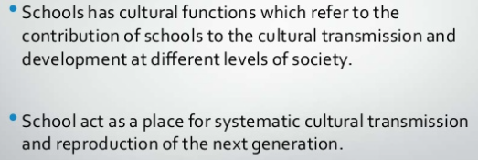
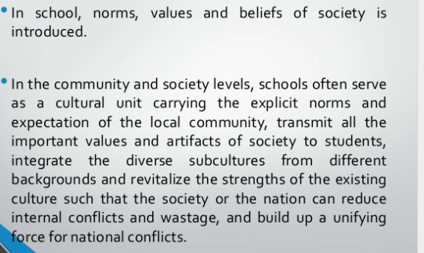
SCHOOL AS A CULTURAL INSTITUTION
Schools must be seen as cultural institutions:

Slide 87
CULTURAL DIFFERENCES TIPS
Teachers should take the time to learn more about the background, values, histories, practices, and traditions of these students and their families.
By doing this, they have the potential to change how they provide instruction. More, teachers who embrace a fuller understanding of their students’ backgrounds and personal experiences can use them as a tool to make connections for all of their students. This is known as culturally responsive teaching.
Teachers are culturally responsive when they:
Acknowledge and respect different cultural heritages
Teach students to understand and appreciate their own and others’ cultural heritages
Recognize the strengths and contributions of individuals from historically underrepresented groups
Activate students’ prior knowledge and connect what they know to what they are learning
Use a wide variety of instructional techniques (e.g., role-playing exercises, storytelling) that align with the way in which the student is taught in his or her own culture
Expand the traditional curriculum to ensure that diverse perspectives are embedded by incorporating multicultural knowledge, resources, and materials in all subjects

Slide 88
CULTURAL DIFFERENCES TIPS
DO
DON’T
Start with positives, such as the benefits of cultural diversity. Highlight that everyone has culture and ask students to reflect on their own cultural beliefs and practices. Discuss the cultural, linguistic and religious diversity of our multicultural society and highlight that, we are all migrants or descendants of migrants.
Don’t start with negatives, such as racism or prejudice. These imply a kind of accusation – an approach unlikely to change attitudes.

Slide 89
CULTURAL DIFFERENCES TIPS
DO
DON’T
Start by discussing the range of possible attitudes to cultural differences, without allowing students to align themselves personally. Then, in a somewhat more detached way, they can work through the consequences of different attitudes.
Don’t start by having students voice their attitudes to cultural differences. This might be the first time they have been asked to voice their feelings on this subject in a formal or public way, and once they have voiced them, they may feel that they have to remain committed to them. This may fix in place and simplify views that are probably more complex and fluid.

Slide 90
CULTURAL DIFFERENCES TIPS
DO
DON’T
Emphasise social cohesion: the way differences can complement and benefit each other. Focus on shared and core values, such as respect, acceptance, generosity and freedom.
Don’t overemphasise ‘ethnic colour’.

Slide 91
CULTURAL DIFFERENCES TIPS
DO
DON’T
Start with positives, such as the benefits of cultural diversity. Highlight that everyone has culture and ask students to reflect on their own cultural beliefs and practices. Discuss the cultural, linguistic and religious diversity of our multicultural society and highlight that, we are all migrants or descendants of migrants.
Don’t start with negatives, such as racism or prejudice. These imply a kind of accusation – an approach unlikely to change attitudes.

Slide 92
CULTURAL DIFFERENCES TIPS
DO
DON’T
Start with positives, such as the benefits of cultural diversity. Highlight that everyone has culture and ask students to reflect on their own cultural beliefs and practices. Discuss the cultural, linguistic and religious diversity of our multicultural society and highlight that, we are all migrants or descendants of migrants.
Don’t start with negatives, such as racism or prejudice. These imply a kind of accusation – an approach unlikely to change attitudes.

Slide 93
CULTURAL DIFFERENCES TIPS
DO
DON’T
Talk about everybody’s differences. Teaching about cultural difference must be inclusive of all students, at all times.
Don’t single out particular groups, such as ‘ethnic groups’.

Slide 94
CULTURAL DIFFERENCES TIPS
DO
DON’T
Incorporate exploration of cultures and intercultural understanding into the curriculum, across the Interpersonal Development, Thinking Processes, Personal Learning and Communication dimensions.
Don’t let talking about difference be an afterthought or an add-on to the curriculum and don’t limit the curriculum by including only singular perspectives.

Slide 95
CULTURAL DIFFERENCES TIPS
DO
DON’T
Talk in such a way that difference means all of us: who we are compared to others, and how we relate to others in our local and global environments. Teachers need to build on every student’s self-interest and the benefits to all students to making the most of our differences.
Don’t give the impression that the reason you are discussing differences is so that the ‘mainstream’ or the ‘majority’ will feel better about ‘minorities’.

Slide 96
CULTURAL DIFFERENCES TIPS
DO
DON’T
Deal with the facts and the practical skills and attitudes we need to succeed in a future of local and global cultural diversity.
Don’t be moralistic. There is no point in accusing people of having bad attitudes, or even implying that they do.

Slide 97
CULTURAL DIFFERENCES TIPS
DO
DON’T
Start with words that students relate to, such as ‘differences’, ‘acceptance’, ‘respect’, ‘justice’ and ‘freedom’. Use these to begin the discussion about why schools and governments have policies on diversity and inclusion.
Don’t be heavy handed with difficult abstract concepts or words, such as ‘multiculturalism’, ‘integration’ and ‘diversity’.

Slide 98
CULTURAL DIFFERENCES TIPS
DO
DON’T
Engage local multicultural community members (parents, staff, community and faith leaders) in discussions about diversity. Hearing first-hand about the diverse experiences and backgrounds of others can be very powerful for students. Also consider including the asylum seeker and the refugee experience in discussions about diversity.
Don’t limit discussions about diversity to only be about long-standing, established migrant communities in your countries. Include discussions about new and emerging communities (i.e. recent arrivals/humanitarian entrants).

Slide 99
Scenario 4 – Cultural Differences Incident Situation Description
ERASMUS + 2019-1-PL01- KA201-06486
Problems in peer relationships

Slide 100
CULTURAL DIFFERENCES INCIDENT
Zayn is a migrant/refugee student from Syria.
He is a very sweet boy, but very shy. He still doesn't get along with anyone because he has difficulties speaking the language of the host country.
Whenever the teacher asks him to speak, he refuses. This refusal increases because every time he tries to say something in class his classmates laugh at him.
On this day, the teacher asked him to talk a little about his name and the story of his family. And she encouraged him to speak a little in his mother tongue.
As soon as he started talking his classmates started laughing.

Slide 101
Scenario 4 – Cultural Differences Incident Concluding Notes
ERASMUS + 2019-1-PL01- KA201-06486
Problems in peer relationships

Slide 102
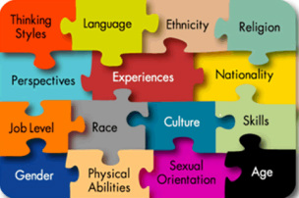
CULTURAL DIFFERENCES KEEP IN MIND...
Cultural diversity is an extremely complex and sometimes highly personal and emotive subject. Thinking about culture and differences between cultures is not just about ‘them’. It is also about ‘us’. It touches the very essence of who ‘we’ are; the core of our own identities.

Slide 103
CULTURAL DIFFERENCES KEEP IN MIND...

Slide 104
Scenario 5 – Racism Incident Conflict Theory
ERASMUS + 2019-1-PL01- KA201-06486
Problems in peer relationships

Slide 105
Peer Relationships - The importance
The manner in which one interacts and forms relationships with others through early childhood, middle childhood, and adolescence is a cornerstone of most major developmental theories (e.g., Erikson, 1968; Parker, Rubin, Erath, Wojslawowicz, & Buskirk, 2006). The formation of social skills that permit effective negotiation of peer-related interactions and interpersonal relationships is arguably one of the most important developmental tasks. As such, peer relationships make a strong contribution to many aspects of normal and abnormal development (Bukowski & Adams, 2005).

Slide 106
possible Causes for Difficulties in peer relationships
Impulsivity
Aggressivity
Communication Disorders
Bullying
Anti-Social Behaviors/Rule Breaking Behaviors
Internalisation Problems
Cultural and Ideological Differences
Disabilities (PHDA)

Slide 107
Understanding racism
The Human Rights Commission defines racism as follows: Racism can take many forms, such as jokes or comments that cause offence or hurt, sometimes unintentionally; name-calling or verbal abuse; harassment or intimidation, or commentary in the media or online that inflames hostility towards certain groups. At its most serious, racism can result in acts of physical abuse and violence. Racism can directly or indirectly exclude people from accessing services or participating in employment, education, sport and social activities. It can also occur at a systemic or institutional level through policies, conditions or practices that disadvantage certain groups. It often manifests through unconscious bias or prejudice. On a structural level, racism serves to perpetuate inequalities in access to power, resources and opportunities across racial and ethnic groups. The belief that a particular race or ethnicity is inferior or superior to others is sometimes used to justify such inequalities.

Slide 108
Understanding racism
Recognition of racism and its intent and impact is an essential part of any anti-racism education strategy. Silence and denial are identified in anti-racism research as two major impediments to countering racism in most countries. Silence and denial are fundamental to the continuing existence of racism. People who are subjected to racial discrimination and intimidation have often been silent about what has happened. Many have come to believe that racism is inevitable or at least unavoidable. Those who practise racism have been inclined to deny its existence or not to recognise or admit to their own racist behaviors. The situation is exacerbated when the racist behaviors have gone unchallenged, as a result of complaints being ignored, diverted or denied. The result is that the effects of racism remain hidden, misunderstood or ignored. It is in this way that racism can become so pervasive that it seems acceptable and normal. Breaking the cycle of silence and denial is an important first step in eliminating racism and building confidence amongst the school community.

Slide 109
Effects of racism
Racism has damaging effects on individuals, families and communities and the learning and working environment. Racism can adversely affect:
educational outcomes
individual happiness and self-confidence
school climate
cultural identity
school and community relations
student behavior.
Racism can generate tensions within school communities which, if unaddressed, impacts on the educational experiences of all students. It can undermine students’ self-confidence and can result in students exhibiting a range of negative behavious. Students who are disaffected with school are less likely to attend school regularly and are more likely to drop out of school earlier than other groups of students. Racism has been linked to diminished morale, lower productivity and an increase in the incidence of stress and absenteeism. Together, the lower participation rates, behavioral problems and feelings of alienation that result from the presence of racism in schools impact on educational outcomes. Educational success depends on the regular sustained attendance of each student and their ability to participate effectively in the classroom. When racism exists in a learning environment, this balance is disrupted and educational outcomes may be limited as a result. Educational outcomes for individual students and student groups who are subject to racism may include lower levels of educational achievement and lower rates of participation in post-school education and training.

Slide 110
Indicators of racism in schools
Recognising racism in schools may be difficult, as racism manifests itself in a range of ways, some more clearly discernible than others. Some indicators of racism include the following:
hostility or lack of co-operation between groups
appearance of racist graffiti
promotion of racist propaganda
display of racist behavior including comments, ridicule or abuse, cyber–racism as well as physical harassment and assault
existence of discriminatory practices including: o low expectations for some groups of students o non-inclusive policies, curriculum and pedagogy denying certain groups access to a wide curriculum.

Slide 111
Racism WHAT TO DO: SCHOOLS?
A whole school approach can be achieved through:
Engaged leadership
A shared and visible commitment by all members of the school community
Recognising that bullying prevention needs ongoing effort
Collaboration and engagement with the whole school community
Adopting a multi-faceted approach rather than a standalone approach or a single strategy
Implementing comprehensive and evidence-based strategies
Professional development for staff to build their capacity to: create an inclusive classroom environment build the skills and knowledge to respond appropriately to racist bullying
School policy and practices that clearly name and address racist bullying
Developing a specific anti-racism policy to support the school’s bullying prevention policy

Slide 112
Racism WHAT TO DO: SCHOOLS?
Self Awareness
The first step to preventing racism in schools is self awareness and self reflection. Educators must recognize how the intersections of race, ethnicity, gender, sexual orientation, religion, socio-economic status, and being able-bodied impact us individually. We must understand how our identification within a particular group gives us privilege in certain spaces and we must be open to actively listen to marginalized groups who experience life differently because of their social groupings. We must acknowledge our personal biases and seek to understand people with different experiences.

Slide 113
Racism WHAT TO DO: SCHOOLS?
Professional Development
In addition to self awareness, educators must invest in professional development opportunities that increase their cultural competence. During the school year look for professional learning opportunities that focus on culturally relevant teaching, cultural competence, diversity, and multiculturalism.

Slide 114
Racism WHAT TO DO: SCHOOLS?
Culturally Relevant Teaching
Teachers can create learning opportunities that acknowledge race and ethnicity, and prioritize preventing racism through social justice with culturally relevant teaching. Culturally relevant teaching emphasizes academic excellence, cultural competence, and social and political analysis. Through culturally relevant teaching, students are engaged in rigorous learning experiences that use text and resources to explore issues within diverse communities. Additionally, there is an emphasis on social justice and social activism.
Culturally relevant teaching uses various texts to address difficult issues of race, culture and ethnicity in thoughtful ways. Culturally relevant teaching exposes students to a variety of people and environments. It is about depth of knowledge and goes far beyond a cultural party where students taste foods and hear music from another culture. Most importantly, culturally relevant teaching promotes social justice and highlights historical movements that have worked to promote tolerance and equity around the world.

Slide 115
Racism WHAT TO DO: SCHOOLS?
Explicit Lessons On Race And Conflict Resolution
To prevent racism educators must talk to students explicitly about racism. Discussions about race can be uncomfortable, but with proper planning, active listening, and a recognition of everyone’s shared vulnerability, an initially uncomfortable conversation can become a transformative learning experience. When we learn about cultures but do not talk about the difficult aspects of our history, we do a disservice to our students and our society.

Slide 116
Racism WHAT TO DO: SCHOOLS?
Awareness Of How Racial Bias Impacts Discipline
Schools must be aware of the racial bias that can affect how students are disciplined. Leaders and teachers must use data to analyze trends in student behavior and uncover disproportionality. Schools can also implement Restorative Practices to provide a restorative, rather than a punitive, approach to school discipline.

Slide 117
Racism WHAT TO DO: SCHOOLS?
Community Partnerships
The effects of racism are systemic and far reaching. Once students have learned about racism they must go out into the world and interact with these issues in real time. Schools must partner with community organizations who are combating issues of racism and equity in their community.
Social justice is an important of component of preventing racism. Inviting community organizations into schools is an excellent way to get students involved in social justice work. Additionally, inviting families into your classroom to talk about their culture or experiences that align with a particular topic is a good way to create community and show your students that their experiences and the experiences of their families are just as valuable as the stories they read about in books.

Slide 118
Racism WHAT TO DO: CLASSROOM?
1. Provide accurate, historical context
Understanding and coming to terms with past racist practices is essential to an anti-racist education. A teacher can take students to visit memorials and museums, or ask them to research place names. Do names in your local community, for example, hark back to racist practices? Teachers can encourage students to critically reflect on whose stories are celebrated in public memory, and brainstorm what would better represent the contributions and experiences of all members of the community.

Slide 119
Racism WHAT TO DO: CLASSROOM?
2. Explain racism is not just done by ‘bad people’
Racism should be taught as a system of racial hierarchy that is sustained consciously and unconsciously by the idea that one group of people is superior. Because of this presumed superiority the ideas, books, voices and expertise of one group are seen as the “norm”.
Racial discrimination today is often referred to as “soft” or “new” racism, often expressed through covert microagressions.
Categorising racism as something only “bad” people do means the “good” ones are denied the opportunity to examine how their everyday thoughts and actions may be sustaining society’s racial hierarchy structure.
The below video of the blue-eyed/brown-eyed experiment (in which kids are told brown-eyed people are superior to blue-eyed people and vice versa), is a good way to show students how unconscious behaviours emerge and how quickly prejudice can form.
WATCH: Video_1

Slide 120
Racism WHAT TO DO: CLASSROOM?
3. Show the impacts of unintended harm
People commonly assume their good intentions bear more weight than their unintended consequences. Just because someone did not intend to be racist, does not lessen the impact on the person experiencing it. You can use metaphors to illustrate this.
For example, if you accidentally pour hot coffee on someone, the natural response is not to say “why are you upset when it wasn’t my intention to pour a hot drink on you?”.
The more appropriate response is to acknowledge your mistake, apologise to the other person and move more carefully in future.
The insidiousness of “new” racism is that people who do not consider themselves racist might actually be perpetuating racism without being aware of it.

Slide 121
Racism WHAT TO DO: CLASSROOM?
4. Encourage students to be brave in calling out racist behaviour
Being silent after observing racist behaviour is being complicit in racism. Teachers need to practise giving constructive feedback on racist speech and behaviour, and support students in being resilient about taking on board anti-racist feedback.
Actively anti-racist teachers are quicker to notice and respond to racial micro-aggressions when they occur in the classroom, such as teaching students not to use racial nicknames or stereotypes.

Slide 122
Racism WHAT TO DO: CLASSROOM?
5. Explain there are hierarchies within racism
Experiences of racism are magnified when different forms of discrimination combine to create a more intensified exclusionary experience for people, based on intersections between their multiple marginalised identities.
Experiences of racism for young black men, for example, may vary a lot from the experiences for young black women. Explain to students it is possible to experience oppression in one identity category but be privileged in another.
Watch: Video_2

Slide 123
Racism WHAT TO DO: CLASSROOM?
6. Be aware of students’ racial trauma
Teachers sometimes strive to teach about racism, without considering that it is the lived experience of some of their students.
Racialised trauma is passed across generations, and can include indirect and direct experiences of interpersonal and systemic racism.
We need to support people who have been traumatised by racism, not just challenge those who instigate it.
Teachers should also be sensitive about the way anti-racist teaching is delivered. If you are going to discuss sensitive topics, you can provide trigger warnings in advance to the class. This way students can prepare or raise concerns in advance.
Be aware of who is in your class and avoid using potentially re-traumatising images, examples or videos.

Slide 124
Racism WHAT TO DO: CLASSROOM?
7. Model inclusive behaviour
Teachers should model anti-racist behaviour in their classroom. For example, they should not mock or say inappropriate things about other people’s cultural and racial backgrounds. Teachers should encourage students to think of the various cultures as different and not superior to, or better than, others.

Slide 125
Racism WHAT TO DO: CLASSROOM?
8. Ensure diversity in the curriculum
We can challenge the historic and continued silencing of alternative voices by integrating diverse voices into our curriculum.
As a teacher, you can select readings, videos, and other classroom resources that are informed by diverse knowledge and experiences.

Slide 126
Racism WHAT TO DO: CLASSROOM?
9. Focus on change, not blame or shame
Discomfort is often an essential part of any learning process, more so for sensitive topics. Anti-racist education should be compassionate and aim to move through discomfort to produce change, rather than instilling shame or blame.
Anti-racist education is often just as much about unlearning, as it is about learning.
We may have to challenge ourselves to unlearn inaccurate history and stereotypes, question our own deeply ingrained thoughts and habits, and practise different ways of listening to, and working with, people from different backgrounds.

Slide 127
Scenario 5 – Racism Incident Situation Description
ERASMUS + 2019-1-PL01- KA201-06486
Problems in peer relationships

Slide 128
Racism incident
The scene takes place in a classroom context.
The teacher is in a history class talking about slavery throughout universal history.
Boris interrupts the teacher and tells everyone that he is in favor of slavery because there are distinct races and some must be subjugated.
Boris is joined by Michael, who feels the same way.
There's a disturbance in the class, all the students are starting to get restless.
Then Susan and Jackson intervene saying that what Boris and Michael have said is a tremendous mistake.
Jackson is angry because they were talking in particular about him, he is the son of migrants and came from Mozambique.
The students argue with each other.

Slide 129
Scenario 5 – Racism Incident Concluding Notes
ERASMUS + 2019-1-PL01- KA201-06486
Problems in peer relationships

Slide 130
Racism keep in mind…
The issue of racial discrimination is especially challenging to deal with in schools. There is a collective intention to create safe spaces for children while educating them. Issues as complex as racism can touch sensitivities, especially in students who have been victims of discrimination.
Nevertheless, recent events motivated by racial violence call for an urgent shift in focus and raise difficult questions. What is the point of protecting children from issues like racism in the classrooms if, outside of these, instances of racial violence happen daily, some of them against the same students we teach?
For those who recognize the social and ethical need to introduce their students to an understanding of systemic racism, we share the following recommendations.

Slide 131
Racism keep in mind…
There are many ways of making the classroom a place of acceptance and of multiracial celebration. Cultural factors influence a student’s responses, such as how much eye contact he or she finds comfortable, how receptive he or she is to group learning strategies, or his or her style of dramatic play or story-telling. If and when there is a racial conflict in the class, deal with it; do not dismiss it.

Slide 132
Racism keep in mind…
Teach your students how to recognize behavior that may reinforce racism.
Study the stories of famous people who have fought against discrimination.
Study the contributions made by people from all parts of the world to the common stock of human knowledge and experience.
Introduce as much cultural diversity as possible into the curriculum.
Ask parents or other relatives or friends to help in this regard.
Invite people of other races or colours who are active in community work to speak to the class about what they do.
Help the class develop a definition of “Minority group”.
Brainstorm with the class a list of contemporary “minority groups”, starting with the local community. Be sure to include minorities based on class, ability, sexual orientation and other non-racial factors.
Seniors students could eventually do case studies to find out about the size, location, history, culture, contemporary living conditions and key claims of specific minority groups.

